Slide 1

OPENING & WELCOME · AUTUMN EDITION 2026
MUNICHTECH EXPO
Silicon Valley in Europe.
20–22 September 2026 · Munich
Built in Munich. Powered by innovation. Driven by AI. Connected by ecosystems.
Prof. Dr. Ahmed Ebada · Founder & Conference Chair
MunichTech EXPO · Opening talk · 10 min · Day 1 Launch
1 / 14

Slide 2
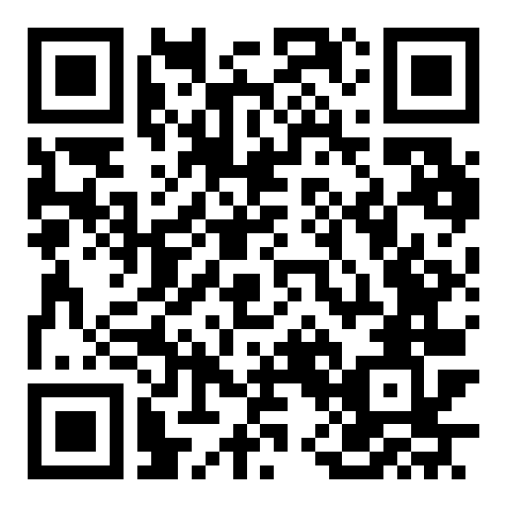
ABOUT THE SPEAKER
Prof. Dr.-Ing. Ahmed Ebada
Professor of AI · Digital Twin Expert · Serial Entrepreneur · Global Keynote Speaker
International technology leader, entrepreneur, and professor working on Artificial Intelligence, Digital Twins, autonomous systems, and digital transformation. Lecturer at FOM München and Adjunct Professor at SRH University of Applied Sciences.
600+
Google Scholar citations
h-14
Research impact (h-index)
CURRENT ROLES
● Lecturer — FOM München · Adjunct Professor — SRH University & IU
● Founder — HOPn, Goldenia, Invoice AI, VitaTwin, SportifyPlus, AIPass
● Co-Founder — Munich Tech EXPO, Sovra AI, Praktix
● Peer Reviewer — IEEE · Elsevier · Springer Nature
9
Major international conferences
200k+
People reached worldwide
TRUSTED BY / PARTNERED WITH
BMW Group · IEEE · Messe München · Hilti · Nordson · MDPI
www.ebada.de
MunichTech EXPO · Opening talk · 10 min
2 / 14

Slide 3
VISION
Europe’s place to build, meet, and scale AI & DeepTech.
● Bring Silicon Valley urgency to European industry, research, and startups.
● Turn one week of meetings into year-round collaboration.
● Connect enterprises, founders, investors, researchers, and governments in one trusted room.
1 million
jobs Europe's deep tech could create by 2030
€1.25B
committed by the EIF and EIB to European tech champions
80
university spin-outs past $1B valuation or $100M revenue
Source: McKinsey, 2025; European Investment Fund, December 2025; Dealroom, 2026.
MunichTech EXPO · Opening talk · 10 min
3 / 14

Slide 4
EUROPE · VENTURE FUNDING
AI led European venture funding for the first time in 2025.
AI funding into European startups
$20.3B
into European deep tech in 2025 — a record 32% of all European VC
+75%
125
European deep tech companies are now unicorns or billion-dollar exits
$1T
enterprise value Europe's deep tech could add by 2030
Source: Crunchbase European venture funding review, 2026; Dealroom, Deep Tech in Europe, 2026; McKinsey, 2025.
MunichTech EXPO · Opening talk · 10 min
4 / 14

Slide 5
THE GAP
Europe invents, then exports the returns.
Venture capital raised per inhabitant, 2025 (approximate)
6%
of global venture capital into AI chips and processors came from Europe, 2022–2025
Europe funds the research, trains the founders and incubates the companies. The returns leave at the growth stage.
Source: German Startup Association, 2026; Dealroom, Deep Tech in Europe, 2026.
MunichTech EXPO · Opening talk · 10 min
5 / 14

Slide 6




WHY WE ORGANIZE THIS
Because Europe needs an implementation capital — not another conference brochure.
Research → product
Move ideas from labs into factories, clinics, and software that ships.
People → deals
Curated matchmaking so the right conversations actually happen.
Munich advantage
Strongest AI ecosystem, academic leaders, DeepTech hub, home to industrial giants.
Open doors
Students, job seekers, corporates, and founders share one programme — with clear pathways.
MunichTech EXPO · Opening talk · 10 min
6 / 14

Slide 7
WHY MUNICH
Bavaria out-raised Berlin for the second year running.
Venture capital raised by startups, 2025
19.3
Munich startups per 100,000 inhabitants — ahead of Berlin's 16.8 for the first time
No. 1
UnternehmerTUM, ranked Europe's leading startup hub by the Financial Times
55%
of Bavarian startups come out of the university environment
Source: EY Start-up Barometer Deutschland, 2026; Startupverband / startupdetector annual report 2025; Bavaria Startup and Scaleup Monitor 2026; Financial Times, 2025.
MunichTech EXPO · Opening talk · 10 min
7 / 14

Slide 8


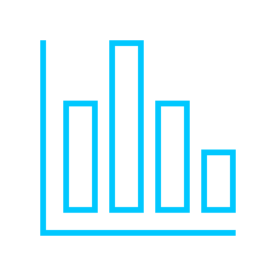

OUR CONCEPT
More than an event. An ecosystem.
Connect
Speakers, partners, buyers, and builders in one city — Main Stage, Arena, Online.
Innovate
Hackathons, challenges, demos, and production AI — not slideware only.
Invest
Startup competition, investor paths, and visible traction.
Transform
Enterprise case studies and research-to-industry transfer.
MunichTech EXPO · Opening talk · 10 min
8 / 14

Slide 9




INNOVATION PLATFORM · YEAR-ROUND
The EXPO week is the peak. The platform runs all year.
Hub membership
Mentors, marketplace, Demo Day access, and Europe ↔ GCC pathways.
Always-on visibility
Founders and partners stay discoverable between editions.
Live all year
Challenges, hackathons, newsroom, and partner programmes stay open.
No Monday drop-off
Relationships started here keep running after the week ends.
MunichTech EXPO · Opening talk · 10 min
9 / 14

Slide 10


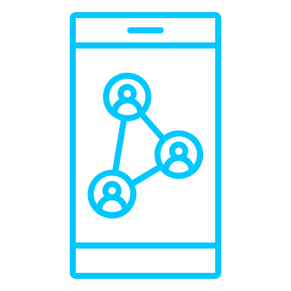
COLLABORATIONS & MATCHMAKING
We design the meetings — not only the stage.
Curated 1:1 matchmaking
Structured introductions across startups, corporates, investors, and talent.
Partner tracks
Governments, universities, corporates, and institutions co-create programmes.
Lounges & roundtables
Executive and closed-door formats for serious conversations.
Network / Matchmaking
Continue on munichtechexpo.com/network after the badge comes off.
MunichTech EXPO · Opening talk · 10 min
10 / 14

Slide 11



CONNECTION APP
Exchange contacts in seconds — then stay connected.
Digital Business Card
Official card for attendees, mentors, and partners.
Scan, save, follow up
No names lost on paper notes at the end of the day.
Use it on site
nextdigicard.online works from any phone browser.
Keep the connection
Continue in Network / Matchmaking after the badge comes off.
MunichTech EXPO · Opening talk · 10 min
11 / 14

Slide 12



STARTUP COMPETITION
Best Startup in Europe — pitch, shortlist, people’s choice.
Showcase
Shortlist on Main Stage. Meet finalists in the programme.
Audience vote
People’s Choice voting on the live awards track.
Hackathon path
Industry challenges with mentors, prizes, and pilot opportunities.
Why it matters
Capital and customers meet founders where Europe builds.
Awards & closing for the hackathon: Tuesday at Google Munich.
MunichTech EXPO · Opening talk · 10 min
12 / 14

Slide 13
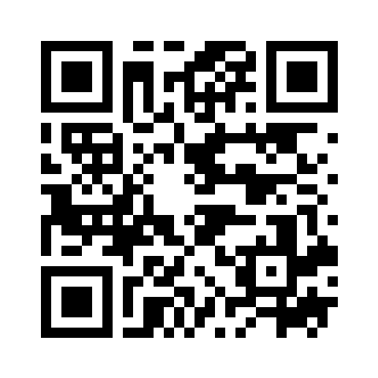
MAIN SUMMIT 2027
Join us 22–24 April 2027 · Munich.
● Flagship Main Summit — AI, DeepTech & innovation.
● Alte Kongresshalle München.
● Scan the QR for the 2027 programme page.
● Save the date. Bring your team. Build with us next year.
Scan → munichtechexpo.com/main-summit-2027
Germany time · Europe/Berlin
MunichTech EXPO · Opening talk · 10 min
13 / 14

Slide 14
THANK YOU
Let's build it together.
Enjoy the programme. Use the DigiCard. Join matchmaking. See you at the Main Summit, 22–24 April 2027.
Prof. Dr. Ahmed Ebada
Founder & Conference Chair · MunichTech EXPO
munichtechexpo.com
MunichTech EXPO · Opening talk · 10 min
14 / 14

