Slide 1
MUNICHTECH EXPO · PRODUCTION EXPERIENCE
Zero-Hop
A/B Testing
In-memory assignment without a request-path dependency
Proven at marketplace scale. Reusable for production AI evaluation.
LOCAL A/B/N SDK
Customer request
Product outcome
→
cached config · deterministic cohort
zero synchronous hop
→
production traffic
what the customer receives
production traffic
request-path isolation
A/B/n for production AI
Aliaksandr Dainiak · Tech Lead
Notes:
TIMING: 0:00-0:40
SAY THIS - SIMPLE ENGLISH
Hello everyone.
I am Aliaksandr Dainiak, a Tech Lead.
Today I will show A/B testing with no experiment-platform call in the request path.
This is especially valuable for AI.
Prompts and models are probabilistic, and offline tests cannot show real product value.
We need safe production comparisons without adding a fragile dependency.
NEXT
First, I want to explain why this rule was important.
SHORT Q&A
Zero-hop means no network call to the experiment platform in the request path. Local code still uses a small amount of CPU.
[Sources]
- Supplied industrial experience report, §6.
[/Sources]

Slide 2
PRODUCTION EXPERIENCE · 02
An experiment-platform failure must not fail customer requests
CENTRAL DECISION
LOCAL EVALUATION
One call per request
Configuration, not decisions
Product service
Experiment service
Control plane
Product service
request handler
slow / unavailable
poll + cache
local decision
Latency and failure spread to every caller
Failure becomes bounded staleness
Aliaksandr Dainiak · MunichTech EXPO
2 / 32
Notes:
TIMING: 0:40-1:25
SAY THIS - SIMPLE ENGLISH
Our first rule was reliability.
If the experiment platform is down, customer requests must continue.
The platform controls configuration, not product availability.
It sends configuration to product services.
The product service decides locally.
If the control plane fails, configuration may become old for a short time.
But the customer request still works.
If the experiment platform is down, the product must continue serving requests.
NEXT
Now let us look at the production scale.
SHORT Q&A
Give a short answer. Use the Simple English Q&A file if you need more detail.
[Sources]
- Supplied industrial experience report, §6 opening rule and §6.1.
[/Sources]

Slide 3
PRODUCTION CONTEXT · 03
3x was the production context, not the performance claim
2-3M
≈90k
3x
monthly active users
orders per day
traffic during major holidays and campaigns
Marketplace operating scale
Approximate daily volume
Observed business context
Real scale grounds the architecture; 3x does not define its limit.
Aliaksandr Dainiak · MunichTech EXPO
3 / 32
Notes:
TIMING: 1:25-2:20
SAY THIS - SIMPLE ENGLISH
The marketplace had about two to three million active users per month.
It processed about ninety thousand orders per day.
During major holidays and large campaigns, traffic could grow about three times.
This three-times number is an observed business fact.
It is not a performance limit or a special benchmark of the A/B SDK.
The important point is different.
We removed a shared request-time dependency.
Production scale is context, not the benchmark.
NEXT
Now let us separate local decision work from control-plane traffic.
SHORT Q&A
Three-times traffic is real production context. It is not a performance limit or a special SDK benchmark.
[Sources]
- Supplied industrial experience report, §2.
[/Sources]

Slide 4
LOAD SHAPE · 04
Request volume must not drive control-plane traffic
CUSTOMER REQUESTS
CONFIGURATION REFRESH
1x
2x
3x
service instances × refresh frequency
Local decisions scale with requests; control-plane traffic scales with instances and refresh.
Aliaksandr Dainiak · MunichTech EXPO
4 / 32
Notes:
TIMING: 2:20-3:15
SAY THIS - SIMPLE ENGLISH
Request volume controls how many local decisions we make.
Three times more requests means three times more hash and memory lookups.
This work is tiny.
Customer requests never call the experiment platform.
Services refresh configuration and keep it in memory.
Control-plane traffic depends on service instances and the refresh interval.
The goal was not to save CPU. The goal was to remove a shared synchronous dependency.
NEXT
We used this design many times every month.
SHORT Q&A
Give a short answer. Use the Simple English Q&A file if you need more detail.
[Sources]
- Supplied industrial experience report, §6 operational benefits.
[/Sources]

Slide 5
OPERATING DEMAND · 05
One cheap calculation became a shared availability concern
≈50
Which variant is this user in?
experiments per month
and growing
The number of experiments was not the problem.
Where the answer came from was.
Placement is an availability decision - not a CPU optimisation.
Aliaksandr Dainiak · MunichTech EXPO
5 / 32
Notes:
TIMING: 3:15-4:10
SAY THIS - SIMPLE ENGLISH
We now run about fifty experiments in an average month.
And the number is growing.
The same question happened again and again.
Which variant should this user receive?
It appeared in checkout, catalogue, promotions and recommendations.
The calculation was small. Its location was important.
A remote answer creates a shared dependency.
A local answer is a small branch inside the product service.
The place of the decision is more important than the cost of the calculation.
NEXT
Let us first look at the central design.
SHORT Q&A
Give a short answer. Use the Simple English Q&A file if you need more detail.
[Sources]
- Supplied industrial experience report, §3.1 and §4.1.
[/Sources]

Slide 6
ALTERNATIVE 1 · 06
The obvious design adds one hop to every experiment-aware request
Central A/B service
Product service
Client
which variant?
once per request
Response
must decide before responding
customer request
after decision
+1 network hop · shared p99 · shared failure domain
Aliaksandr Dainiak · MunichTech EXPO
6 / 32
Notes:
TIMING: 4:10-5:55
SAY THIS - SIMPLE ENGLISH
Here is the common central design.
The client calls a product service.
The product service needs an experiment variant.
It calls the central A/B service.
Then it waits for the answer.
This design is easy to understand.
It gives one central place for rules and control.
For many companies, it can be a good design.
But it adds one network call to every experiment request.
Its slow requests become part of every product service’s slow requests.
If it has an outage, many product paths can have problems together.
The problem is not tuning. The problem is the request-path dependency.
NEXT
This dependency creates three problems.
SHORT Q&A
Give a short answer. Use the Simple English Q&A file if you need more detail.
[Sources]
- Supplied industrial experience report, §6.1 Alternatives Rejected.
[/Sources]

Slide 7
WHY THE HOP HURTS · 07
A request-time decision service makes failure contagious
Latency
Load amplification
Blast radius
Its p99 becomes part of every caller's p99.
Peak customer RPS becomes peak internal decision RPS.
A decision-service incident spreads across unrelated product paths.
HTTP-header assignment avoids the central call, but grows into a cross-service serialization contract.
Aliaksandr Dainiak · MunichTech EXPO
7 / 32
Notes:
TIMING: 5:55-7:10
SAY THIS - SIMPLE ENGLISH
The first problem is latency.
The slowest calls of the A/B service become part of the product latency.
The second problem is load.
Peak customer traffic becomes peak traffic for the A/B service.
The third problem is the size of an outage.
One decision-service problem can affect many unrelated product services.
We also considered sending the variant in HTTP headers.
This removes the central call.
But the header becomes a shared data format between many services.
It is also difficult for jobs that do not use HTTP.
We wanted central control, but local decisions.
NEXT
This is the architecture we used.
SHORT Q&A
Give a short answer. Use the Simple English Q&A file if you need more detail.
[Sources]
- Supplied industrial experience report, §6.1.
[/Sources]

Slide 8
LOCAL EVALUATION · 08
Publish configuration; resolve where the request already is
EXPERIMENT CONTROL PLANE
configuration · targeting · allocation
poll + cache ↓
Mobile client
REQUEST-OWNING SERVICE
Product behaviour
receives relevant settings
Local SDK resolves the variant
variant applied now
stable id + cached config + local context
async event ↓
Kafka
Warehouse
assignment / exposure
join business outcomes
0 request-path calls to the A/B platform — by construction, not by tuning.
Aliaksandr Dainiak · MunichTech EXPO
8 / 32
Notes:
TIMING: 7:10-9:00
SAY THIS - SIMPLE ENGLISH
The A/B platform stores experiment configuration.
Every product service uses an SDK.
The SDK downloads the configuration on a timer.
It keeps the configuration in memory.
When a customer request arrives, the product service already has the user or installation ID.
The SDK chooses the variant locally.
There is no database lookup.
There is no call back to the A/B platform.
After the decision, the service sends an event to Kafka.
Later, the warehouse connects this event with conversion, retention and value.
The platform sends the rules. The product service decides. The warehouse checks the result.
NEXT
The local decision is a small and stable calculation.
SHORT Q&A
Give a short answer. Use the Simple English Q&A file if you need more detail.
[Sources]
- Supplied industrial experience report, Figure 4 and §6.
[/Sources]

Slide 9
MECHANISM · 09
The request path is one deterministic computation
bucket = hash(installationId) mod 100
Pull + cache
Resolve locally
Separate cohorts
Refresh experiment configuration on a timer.
Use installationId; userId for authenticated-only experiments.
Use disjoint ranges when experiments must not overlap.
The published implementation used stable identifiers and disjoint ranges - no experiment-id salting is claimed here.
Aliaksandr Dainiak · MunichTech EXPO
9 / 32
Notes:
TIMING: 9:00-10:35
SAY THIS - SIMPLE ENGLISH
This is the bucket formula from the production system.
We hash the installation ID.
Then we take modulo one hundred.
The result is a bucket from zero to ninety-nine.
For tests with logged-in users only, we can use user ID.
The same ID gives the same bucket again and again.
This gives stable groups.
Different services also get the same answer if they use the same hashing rules.
For experiments that must not overlap, we use separate bucket ranges.
Stable input gives stable assignment without a network call.
NEXT
Experiment events must also stay outside the request path.
SHORT Q&A
I show the production formula: hash of installation ID, modulo one hundred.
[Sources]
- Supplied industrial experience report, §6.2.
[/Sources]

Slide 10
TELEMETRY · 10
Evidence flows asynchronously too
Kafka
Runtime service
Warehouse
buffers runtime from analytical storage
assignment / exposure event
join conversion, retention and value
A slow warehouse must not slow customer requests.
Product analytics may be exploratory; the warehouse remains authoritative.
Aliaksandr Dainiak · MunichTech EXPO
10 / 32
Notes:
TIMING: 10:35-11:45
SAY THIS - SIMPLE ENGLISH
An experiment needs good data.
But the customer must not wait for the data warehouse.
The service sends assignment and exposure events asynchronously.
Kafka stores these events between the product service and analytics.
The warehouse joins them with business results.
For example: orders, conversion, retention or order value.
We still monitor missing events and data quality.
Asynchronous does not mean unimportant.
It means that an analytics problem must not slow down customer requests.
A slow warehouse must not slow customer requests.
NEXT
What happens if the A/B platform stops working?
SHORT Q&A
Give a short answer. Use the Simple English Q&A file if you need more detail.
[Sources]
- Supplied industrial experience report, §6.3.
[/Sources]

Slide 11
BOUNDED FAILURE · 11
When the A/B platform fails, the request path does not
Last-known config
Control plane
Customer request
held in memory
temporarily unavailable
continues normally
The cost of failure is delayed propagation.
Not a failed checkout. Not a cascading timeout.
A control-plane outage delays changes; it does not fail checkout.
Aliaksandr Dainiak · MunichTech EXPO
11 / 32
Notes:
TIMING: 11:45-12:50
SAY THIS - SIMPLE ENGLISH
For a running service, the answer is: almost nothing happens.
The service still has configuration in memory.
The same user still gets the same variant.
Customer requests continue.
The team temporarily cannot start, stop or change an experiment.
New configuration arrives later.
So the problem is configuration freshness.
It is not customer availability.
A new service instance also needs a safe default or a saved starting configuration.
The outage delays a change. It does not stop the customer journey.
NEXT
A small runtime design also kept the build cost small.
SHORT Q&A
Give a short answer. Use the Simple English Q&A file if you need more detail.
[Sources]
- Supplied industrial experience report, §6 operational benefits and §10.1.
[/Sources]

Slide 12
BUILD ECONOMICS · 12
A small runtime surface kept the build bounded
≈42
≈50
Break-even
person-days to first production
experiments per month and growing
months,
not years
against enterprise MAU / seat / event pricing
Engineering-delivery estimate
Observed operating cadence
Architecture, data control and TCO aligned. This is not a universal build recommendation.
Aliaksandr Dainiak · MunichTech EXPO
12 / 32
Notes:
TIMING: 12:50-13:55
SAY THIS - SIMPLE ENGLISH
The first production version took about forty-two person-days.
It now supports about fifty experiments in an average month.
And the number is growing.
These are engineering estimates.
They are not exact accounting numbers.
The break-even time was measured in months, not years.
We did not build every feature of a large commercial platform.
We built the parts that our product needed.
A control plane.
A small SDK.
An event pipeline.
And warehouse analysis.
Build worked here because the required system was small and specific.
NEXT
Now I need to explain the scope of our performance numbers.
SHORT Q&A
Give a short answer. Use the Simple English Q&A file if you need more detail.
[Sources]
- Supplied industrial experience report, §4.1 and Appendix A.
[/Sources]

Slide 13
MEASUREMENT HONESTY · 13
Performance numbers need a measurement boundary
OBSERVED TELEMETRY
WHAT IT DOES NOT MEASURE
≈4 ms p95
Not the A/B SDK
Not end-to-end latency
Not user-perceived rendering
Not a fleet-wide percentile
≈0.1 CPU core per pod
2 replicas
WebSocket delivery layer · same cluster
24-hour per-pod telemetry
The zero-hop A/B claim is architectural: there is no experiment-service call left to benchmark.
Aliaksandr Dainiak · MunichTech EXPO
13 / 32
Notes:
TIMING: 13:55-15:10
SAY THIS - SIMPLE ENGLISH
The report contains a number of about four milliseconds at P ninety-five.
It also shows about zero point one CPU core per pod and two replicas.
These numbers are real.
But they are not measurements of the A/B SDK.
They belong to the WebSocket delivery layer in the same cluster.
The four-millisecond number is per pod over twenty-four hours.
It is not full end-to-end latency.
It is not user-visible screen time.
The A/B claim is architectural.
There is no experiment-service call to measure.
Always say what component a performance number belongs to.
NEXT
Fast assignment is not the same as a correct experiment result.
SHORT Q&A
The four-millisecond number belongs to the WebSocket layer, not the A/B SDK.
[Sources]
- Supplied industrial experience report, §5 and Appendix A measurement definitions.
[/Sources]

Slide 14
EXPERIMENT VALIDITY · 14
Fast assignment does not guarantee valid conclusions
RUNTIME LAYER
WAREHOUSE LAYER
deterministic buckets
sticky assignment
mutually exclusive cohorts
asynchronous events
SRM checks
A/A tests
pre-registered guardrails
multiple-metric correction
A cheap assignment can still produce an expensive false conclusion.
Aliaksandr Dainiak · MunichTech EXPO
14 / 32
Notes:
TIMING: 15:10-16:15
SAY THIS - SIMPLE ENGLISH
The runtime layer makes a fast and stable decision.
The warehouse layer checks if the result can be trusted.
These are different jobs.
The SDK handles buckets, stable groups and local evaluation.
The warehouse checks group sizes, A/A tests, safety metrics and many-metric corrections.
A very fast SDK can still produce a wrong conclusion.
For example, events can be missing.
Or eligibility rules can be different in two services.
The SDK makes the experiment fast. The warehouse makes the result believable.
NEXT
Here are the real checks from our large experiment.
SHORT Q&A
Give a short answer. Use the Simple English Q&A file if you need more detail.
[Sources]
- Supplied industrial experience report, §6.4.
[/Sources]

Slide 15
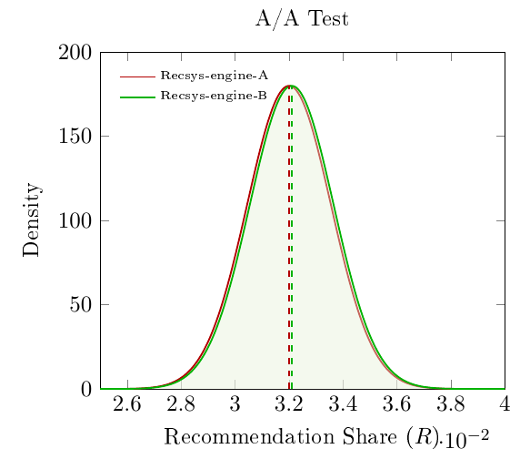
VALIDITY EVIDENCE · 15
The flagship experiment passed four smoke tests
SRM
χ²(1) ≈ 1.6 · p ≈ 0.20
259,962 vs 259,039 users
A/A
Δ ≈ 0 · p ≈ 1.0
two non-intersecting halves
Guardrail
AROV: no significant move
registered before launch
Multiplicity
FDR correction
multiple metrics
A boring A/A plot is the result you want.
These checks rule out gross failures; they do not prove the entire pipeline is unbiased.
Aliaksandr Dainiak · MunichTech EXPO
15 / 32
Notes:
TIMING: 16:15-17:55
SAY THIS - SIMPLE ENGLISH
We used four important checks.
First, we checked the group sizes.
The groups had 259,962 and 259,039 users.
The S R M result had a P value of about zero point two zero.
This did not show a large group-size problem.
Second, we ran an A A test.
Two groups using the same engine gave almost the same result.
The difference was close to zero.
Third, average value for recommended orders did not change significantly.
Fourth, we corrected for many metrics.
One small P value is not enough. We need several independent checks.
NEXT
We also planned the sample size before launch.
SHORT Q&A
The checks did not find a large allocation or measurement problem. They cannot prove that every possible bias is absent.
[Sources]
- Supplied industrial experience report, §7 experiment protocol, Figure 7 and Appendix A.1.
[/Sources]

Slide 16
POWER ANALYSIS · 16
Power was planned before launch
2.26%
0.8 pp
≈85%
≈7.4k
baseline recommendation share
minimum detectable effect
statistical power at 95% confidence
required users per arm
Realised arms: ≈260k users each
The sample size was a decision made before launch - not a number discovered afterwards.
Aliaksandr Dainiak · MunichTech EXPO
16 / 32
Notes:
TIMING: 17:55-19:00
SAY THIS - SIMPLE ENGLISH
Before the test, the main metric was two point two six percent.
We wanted to detect a change of zero point eight percentage points.
We used ninety-five percent confidence and about eighty-five percent statistical power.
The calculation required about seven thousand four hundred users in each group.
In reality, we had about 260 thousand users in each group.
The important point is not only the large sample.
We decided the minimum useful change before we saw the result.
Plan the sample size before the experiment starts.
NEXT
Local evaluation also has limits.
SHORT Q&A
We planned about seven thousand four hundred users per group before launch.
[Sources]
- Supplied industrial experience report, Appendix A.1 power analysis.
[/Sources]

Slide 17
DESIGN BOUNDARY · 17
Local evaluation is free only while every input is local
Segment targeting
Weekly grocery buyers are not a modulo of a hash.
Segment size
Millions of user IDs cannot live in every process cache.
Consistency
Timer-based refresh creates a bounded propagation window.
Exposure
Assignment can happen even when the user never sees the variant.
These are boundaries of the design - not bugs in it.
Aliaksandr Dainiak · MunichTech EXPO
17 / 32
Notes:
TIMING: 19:00-20:25
SAY THIS - SIMPLE ENGLISH
Hashing one ID is easy and local.
Product targeting can be more difficult.
For example, “weekly grocery buyers” is not a simple hash rule.
We cannot put millions of user IDs into every service memory.
Large groups may need a database, a prepared signal or a smaller data format.
Configuration refresh also creates a short delay between services.
Another important question is exposure.
A service can assign a variant even if the user never sees it on the screen.
We should record assignment and real exposure separately.
Local evaluation is cheap only when all required inputs are already local.
NEXT
This leads to a wider build-versus-buy rule.
SHORT Q&A
Give a short answer. Use the Simple English Q&A file if you need more detail.
[Sources]
- Supplied industrial experience report, §6.5 and §10.
[/Sources]

Slide 18
WIDER PRINCIPLE · 18
Scale alone never decides build versus buy
BUILD WHEN
BUY WHEN
high-volume
differentiating
data-sensitive
coupled to your request path
regulated
commodity
cheap at your scale
outside operational maturity
and you can own the consequences
Payment volume was high. We still bought the gateway.
Build versus buy is a decision about what you are willing to own.
Aliaksandr Dainiak · MunichTech EXPO
18 / 32
Notes:
TIMING: 20:25-21:25
SAY THIS - SIMPLE ENGLISH
High traffic alone is not a reason to build.
Build can be a good choice when a system is important for product difference.
It can also be a good choice when it needs private internal data or sits directly in the request path.
But the company must be ready to operate and support it.
Buy can be better for standard or regulated systems.
It can also be better when a vendor is cheap enough and the company does not want the operational work.
For example, payment volume was high, but we still bought the payment gateway.
Build versus buy is a decision about what we are ready to own.
NEXT
A recommendation engine gave us another real example.
SHORT Q&A
Give a short answer. Use the Simple English Q&A file if you need more detail.
[Sources]
- Supplied industrial experience report, §3 and §9.
[/Sources]

Slide 19
RECOMMENDATION HEAD-TO-HEAD · 19
A second case showed why architectural fit must meet production evidence
9M
750k
≈614k items
items in the marketplace catalogue
managed-service training cap
managed arm after filtering
≈1/15 of the catalogue
Observed early-mid 2025
Control: AWS Personalize · USER_PERSONALIZATION v2 · standard configuration
+48.9%
+41.8%
−1.4% raw
recommendation-share ratio
2.26% → 3.36%
surface add-to-cart
3.30% → 4.68%
total orders
≈−1.1% per user · no demand growth
AROV guardrail: no significant difference
Aliaksandr Dainiak · MunichTech EXPO
19 / 32
Notes:
TIMING: 21:25-23:25
SAY THIS - SIMPLE ENGLISH
The marketplace catalogue had about nine million items.
The managed recommendation service could train on a maximum of 750 thousand items.
After filtering, the managed system used about 614 thousand items.
This was about one fifteenth of the full catalogue.
The control was A W S Personalize.
It used the standard User Personalization version two recipe.
We ran a seven-day production A/B test.
Each group had about 260 thousand users.
The share of orders with recommended items grew by forty-eight point nine percent.
Add-to-cart on the recommendation surface grew by forty-one point eight percent.
Total orders were one point four percent lower in raw counts.
They were about one point one percent lower per user.
The average-revenue-per-order guardrail showed no significant difference.
So we do not claim growth in total demand.
So our conclusion is narrow.
The internal engine was better on the recommendation surface.
NEXT
Now I want to show why this architecture matters even more for production A I systems.
SHORT Q&A
The control was A W S Personalize with User Personalization version two. Total orders were 1.4 percent lower raw, so no demand growth is claimed.
[Sources]
- Supplied industrial experience report, §7 and Appendix A.1.
[/Sources]

Slide 20
AI PRODUCTION STAGE 2 · 20
AI Production Stage 2 begins when demos meet real traffic
The demo proves possibility. Production experiments prove value safely.
LATENCY
COST
AVAILABILITY
Real users wait for the full system
Every extra call has a token and tool bill
An evaluator must not become a new outage path
The hard part is comparison under real load — without slowing or destabilising the product.
Aliaksandr Dainiak · MunichTech EXPO
20 / 32
Notes:
TIMING: 23:25-25:10
SAY THIS - SIMPLE ENGLISH
I call this the second production stage of A I.
This is my framing. It is not an official industry standard.
In the first stage, a team proves that an A I demo can work.
In the second stage, the question changes.
Can we compare A I systems with real users and real traffic?
Can we do this without a slower checkout, uncontrolled token cost, or a new production outage?
The difficult part is not one good answer.
The difficult part is safe comparison under real load.
We must protect latency, cost and availability.
The demo proves possibility. Production experiments prove value safely.
NEXT
Before we build the platform, we should understand three common experiment mistakes.
SHORT Q&A
AI Production Stage 2 is my framing, not an official industry standard. No finished L L M result is claimed.
[Sources]
- Speaker synthesis and application pattern derived from the supplied production experimentation architecture; no LLM result is claimed.
[/Sources]

Slide 21
AI EXPERIMENT DESIGN · 21
Three AI experiment mistakes make the result unknowable
OFFLINE ONLY
RANDOMISE EACH TURN
CHANGE EVERYTHING
A benchmark looks good
One conversation switches systems
Model, prompt, knowledge and retrieval move
Real latency, cost and user behaviour stay invisible
Context and the user experience break
The cause of the result is unknowable
Stable unit · versioned treatment · one main axis at a time
Aliaksandr Dainiak · MunichTech EXPO
21 / 32
Notes:
TIMING: 25:10-27:20
SAY THIS - SIMPLE ENGLISH
The first mistake is offline-only evaluation.
A prompt can look good in a benchmark.
But the benchmark does not show real waiting time, real cost or real user behaviour.
The second mistake is changing the prompt on every turn.
One conversation receives different systems.
Context breaks, and the user experience becomes confusing.
The third mistake is changing everything together.
The team changes the model, prompt, knowledge source and retrieval system.
Then the result moves, but nobody knows why.
These mistakes happen before the statistics.
Use one stable experiment unit: a conversation, a user or an account.
Save the full treatment version.
Change one main thing at a time.
Bad experiment design cannot be repaired by a small P value.
NEXT
We can now define a simple production contract for the platform.
SHORT Q&A
Use one stable experiment unit, version the full treatment and change one main axis at a time.
[Sources]
- Speaker synthesis based on established online experimentation principles; no LLM uplift is claimed.
[/Sources]

Slide 22
CLOSING · 22
Three ideas to take home
KEEP THE DECISION LOCAL
SEPARATE SPEED FROM TRUST
MAKE AI EXPERIMENTS STABLE
Publish configuration. Resolve variants where the request already is.
The SDK assigns. Exposure data and warehouse checks make the result credible.
Assign once, version the treatment and protect latency, cost, safety and availability.
Experimentation should accelerate delivery — not become the next bottleneck.
Thank you · Questions
Aliaksandr Dainiak · Tech Lead
Aliaksandr Dainiak · MunichTech EXPO
22 / 32
Notes:
TIMING: 27:20-30:30; Q&A 30:30-35:00
SAY THIS - SIMPLE ENGLISH
I will finish with three ideas.
First, keep the decision local.
Publish configuration.
Resolve the variant where the customer request already is.
This protects the request path from a new network dependency.
Second, separate speed from trust.
The local S D K assigns quickly.
Exposure data and warehouse checks make the result credible.
Third, make A I experiments stable.
Assign once for a conversation, user or account.
Version the full treatment.
Change one main thing at a time.
Use offline tests as a gate and online groups for product value.
Protect latency, cost, safety and availability, and keep a safe fallback.
Experimentation should accelerate delivery. It should not become the next bottleneck.
Thank you. I am ready for your questions.
NEXT
Open a backup slide only if it helps answer the question.
SHORT Q&A
Keep the decision local. Separate speed from trust. Make A I experiments stable.
[Sources]
- Synthesis of the supplied industrial experience report and the AI experiment-design pattern shown on Slides 20-21.
[/Sources]

Slide 23
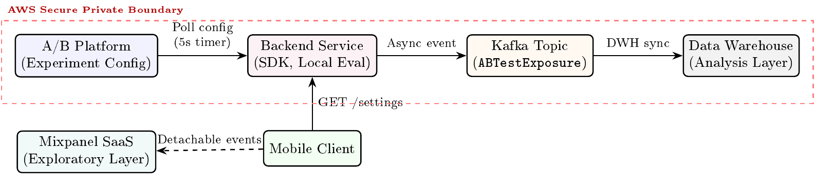
ARCHITECTURE · 23
Backup · Production architecture at a glance
The control plane distributes configuration. Each service evaluates locally and emits evidence asynchronously.
Aliaksandr Dainiak · MunichTech EXPO
23 / 32
Notes:
TIMING: Backup only
SAY THIS - SIMPLE ENGLISH
The platform sends configuration. Product services keep it in memory and choose variants locally. Kafka sends events to the warehouse later.
NEXT
Return to the question.
SHORT Q&A
Give a short answer. Use the Simple English Q&A file if you need more detail.
[Sources]
- Supplied industrial experience report, Figure 4 and §6.1-§6.3.
[/Sources]

Slide 24
REJECTED ALTERNATIVES · 24
Backup · Three designs were considered
Central decision service
Simple governance
+1 request-time hop; shared p99 and failure domain
Assignment in HTTP headers
No central request call
Cross-service serialization contract; awkward for non-HTTP work
Local SDK evaluation
No request-path network call
Requires bounded refresh and consistent hashing across SDKs
The winning design moved a deterministic computation into the service that already owned the request.
Aliaksandr Dainiak · MunichTech EXPO
24 / 32
Notes:
TIMING: Backup only
SAY THIS - SIMPLE ENGLISH
We compared a central service, HTTP headers and a local SDK. The local SDK removed the request-time network dependency.
NEXT
Return to the question.
SHORT Q&A
Give a short answer. Use the Simple English Q&A file if you need more detail.
[Sources]
- Supplied industrial experience report, §6.1 Alternatives Rejected.
[/Sources]

Slide 25
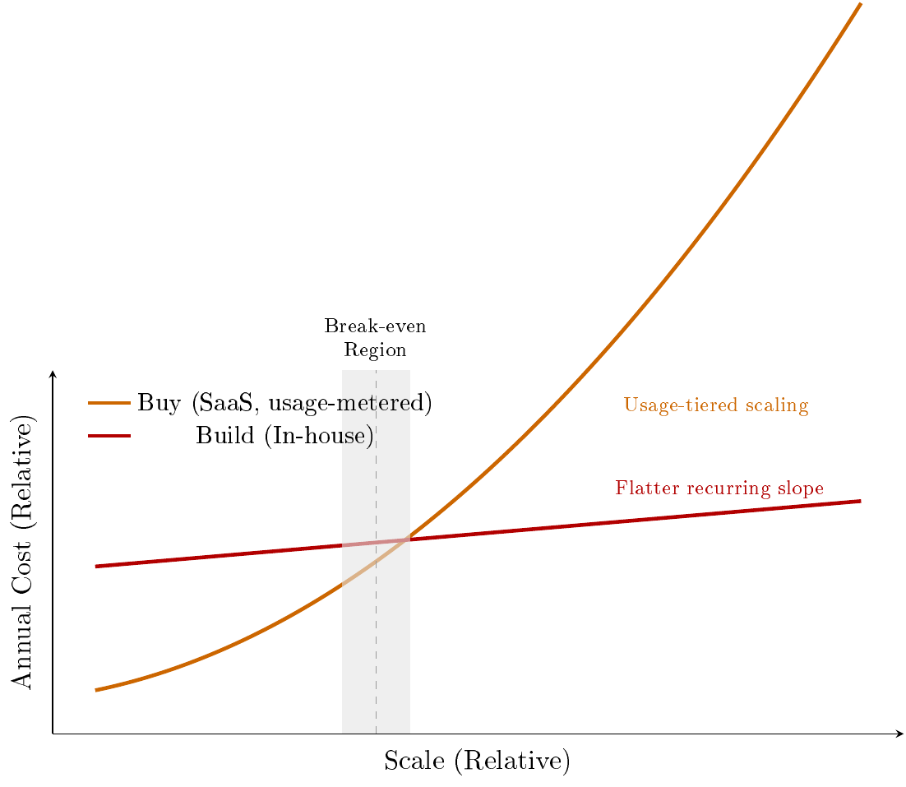
TCO MODEL · 25
Backup · Build cost crosses managed cost only after repetition
Conceptual curve · use measured inputs; do not read exact values from the drawing
Aliaksandr Dainiak · MunichTech EXPO
25 / 32
Notes:
TIMING: Backup only
SAY THIS - SIMPLE ENGLISH
This picture shows the general cost idea. It does not show exact prices. Repeated use pays back the first build cost.
NEXT
Return to the question.
SHORT Q&A
Give a short answer. Use the Simple English Q&A file if you need more detail.
[Sources]
- Supplied industrial experience report, Figure 2, §4.1 and §6.5.
[/Sources]

Slide 26
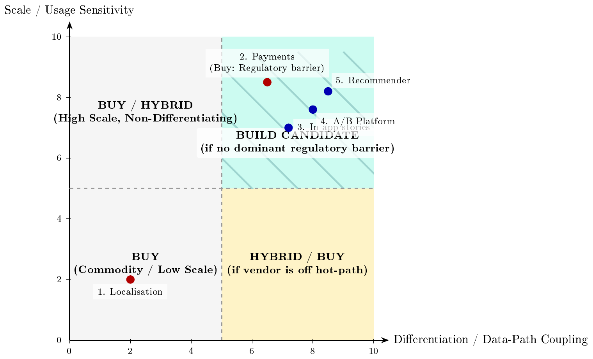
BUILD VERSUS BUY · 26
Backup · The decision boundary is multi-dimensional
High volume is not sufficient. Differentiation, data coupling, latency sensitivity and ownership complete the decision.
Aliaksandr Dainiak · MunichTech EXPO
26 / 32
Notes:
TIMING: Backup only
SAY THIS - SIMPLE ENGLISH
High traffic is only one factor. Product difference, data, latency and operational ownership are also important.
NEXT
Return to the question.
SHORT Q&A
Give a short answer. Use the Simple English Q&A file if you need more detail.
[Sources]
- Supplied industrial experience report, Figure 1 and §3.
[/Sources]

Slide 27
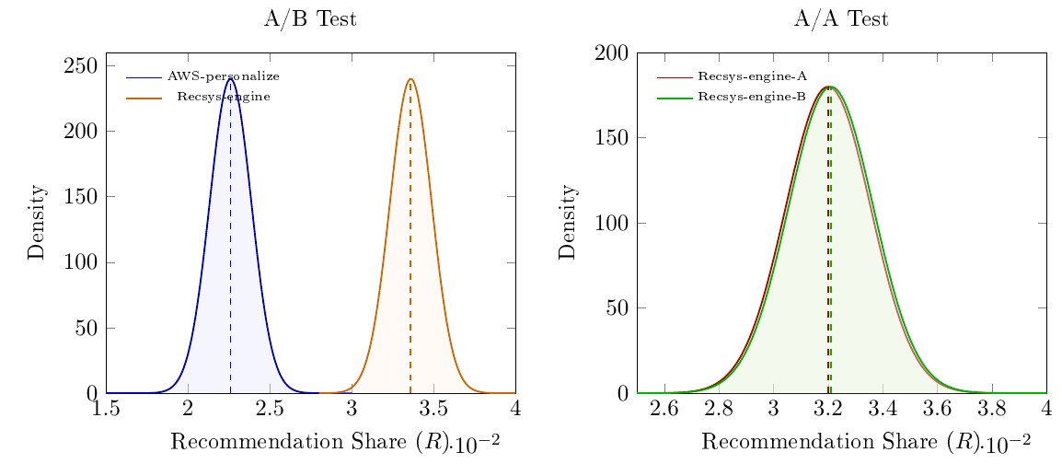
VALIDITY EVIDENCE · 27
Backup · Bootstrap separates A/B and collapses A/A
A/B
p < 0.001 across t-test, Mann-Whitney and user-level bootstrap
A/A
129,331 vs 129,708 users · delta ≈ 0 · p ≈ 1.0
Aliaksandr Dainiak · MunichTech EXPO
27 / 32
Notes:
TIMING: Backup only
SAY THIS - SIMPLE ENGLISH
The A B results are clearly different. The A A results are almost the same. This is what we want to see.
NEXT
Return to the question.
SHORT Q&A
Give a short answer. Use the Simple English Q&A file if you need more detail.
[Sources]
- Supplied industrial experience report, Figure 7 and Appendix A.1-A.2.
[/Sources]

Slide 28
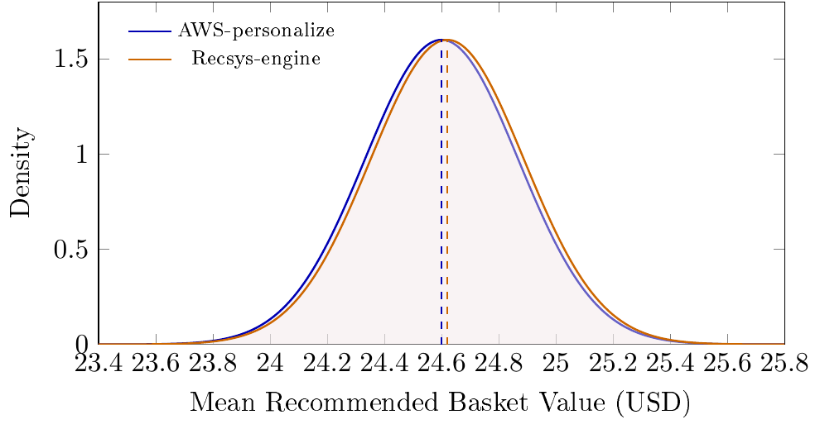
GUARDRAIL · 28
Backup · The revenue guardrail did not move
No significant AROV difference under t-test, Mann-Whitney U or bootstrap
Aliaksandr Dainiak · MunichTech EXPO
28 / 32
Notes:
TIMING: Backup only
SAY THIS - SIMPLE ENGLISH
Average value for recommended orders did not change significantly between the two groups.
NEXT
Return to the question.
SHORT Q&A
Give a short answer. Use the Simple English Q&A file if you need more detail.
[Sources]
- Supplied industrial experience report, Figure 8 and Appendix A.3.
[/Sources]

Slide 29
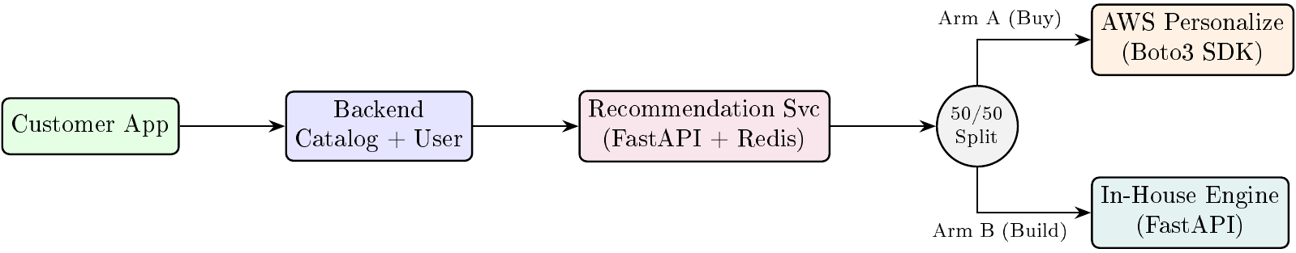
CONTROLLED SPLIT · 29
Backup · Equal context entered both paths
Seven days · 50/50 by user ID · identical backend context into both production paths
Aliaksandr Dainiak · MunichTech EXPO
29 / 32
Notes:
TIMING: Backup only
SAY THIS - SIMPLE ENGLISH
Both engines received the same backend data. We compared the two complete production paths.
NEXT
Return to the question.
SHORT Q&A
Give a short answer. Use the Simple English Q&A file if you need more detail.
[Sources]
- Supplied industrial experience report, Figure 6 and §7.
[/Sources]

Slide 30
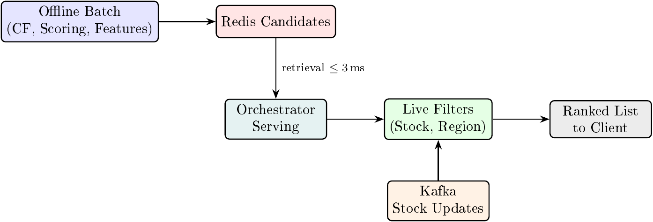
RECOMMENDATION PATH · 30
Backup · Ranking computation stayed offline
Observed serving components: Redis retrieval up to ≈3 ms · managed call around 50 ms
Aliaksandr Dainiak · MunichTech EXPO
30 / 32
Notes:
TIMING: Backup only
SAY THIS - SIMPLE ENGLISH
Heavy work ran offline. The online service read prepared candidates from Redis and applied current product filters.
NEXT
Return to the question.
SHORT Q&A
Give a short answer. Use the Simple English Q&A file if you need more detail.
[Sources]
- Supplied industrial experience report, Figure 5 and §7.
[/Sources]

Slide 31
MEASUREMENT SCOPE · 31
Backup · Numbers are comparable only inside their measurement boundary
METRIC
BOUNDARY
WHAT MAY BE SAID
A/B assignment
Architectural property
No synchronous call to the experimentation control plane
WebSocket processing
Per-pod p95 · 24-hour window
≈4 ms · not aggregated across the fleet
WebSocket connections
Observed per pod
≈600-650 across two replicas in the reported deployment
Backend-to-client delivery
Transport measurement
≈300-330 ms · not user-perceived rendering latency
Aliaksandr Dainiak · MunichTech EXPO
31 / 32
Notes:
TIMING: Backup only
SAY THIS - SIMPLE ENGLISH
Before using a number, please check the component, time window and exact measurement shown in this table.
NEXT
Return to the question.
SHORT Q&A
Give a short answer. Use the Simple English Q&A file if you need more detail.
[Sources]
- Supplied industrial experience report, §2 measurement-scope note and §5.
[/Sources]

Slide 32
RESULT TABLE · 32
Backup · Full recommendation head-to-head
METRIC
CONTROL
TEST
CHANGE
Users
259,962
259,039
balanced
Total orders
254,228
250,621
-1.4% raw
Orders via recommendations
5,734
8,418
+46.8%
Recommendation share
2.26%
3.36%
+48.9%
Add-to-cart on surface
3.30%
4.68%
+1.38 pp / +41.8%
Users ordering via recs
2.11%
3.08%
+0.97 pp
Scope: engine-versus-engine on the recommendation surface · no no-recommendation holdout
Aliaksandr Dainiak · MunichTech EXPO
32 / 32
Notes:
TIMING: Backup only
SAY THIS - SIMPLE ENGLISH
The main result is on the recommendation surface. We do not claim that total marketplace orders increased.
NEXT
Return to the question.
SHORT Q&A
Give a short answer. Use the Simple English Q&A file if you need more detail.
[Sources]
- Supplied industrial experience report, Table 3, §7 and Appendix A.1.
[/Sources]

