Slide 1
The Power and Challenges of AI in Advertising
Munich TechExpo
Prof. Dr. Verena Hofmann
Notes:
Stand Sommersemester 2022

Slide 2

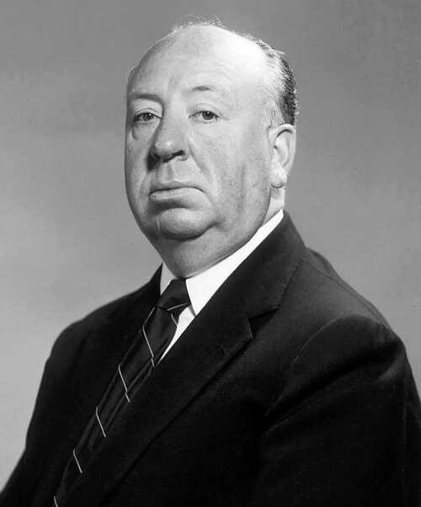

Slide 3
1
The Hidden Power of Unconscious Emotions

Slide 4
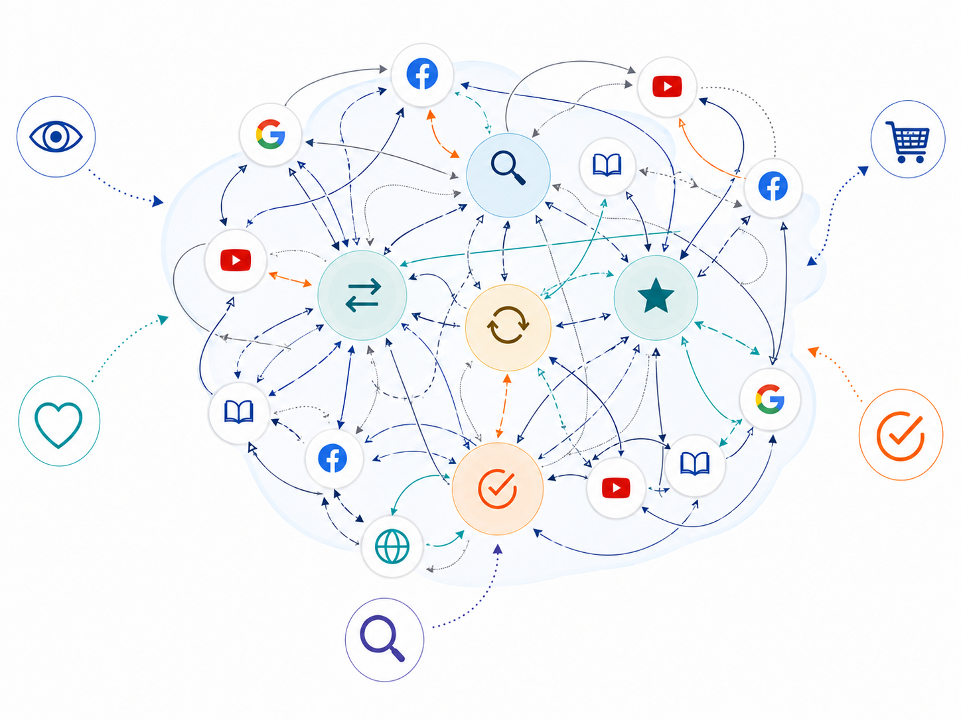

The Customer Journey Fuzzy
Views
Conver-sions
THE FUZZY MIDDLE?!
Clicks

Slide 5
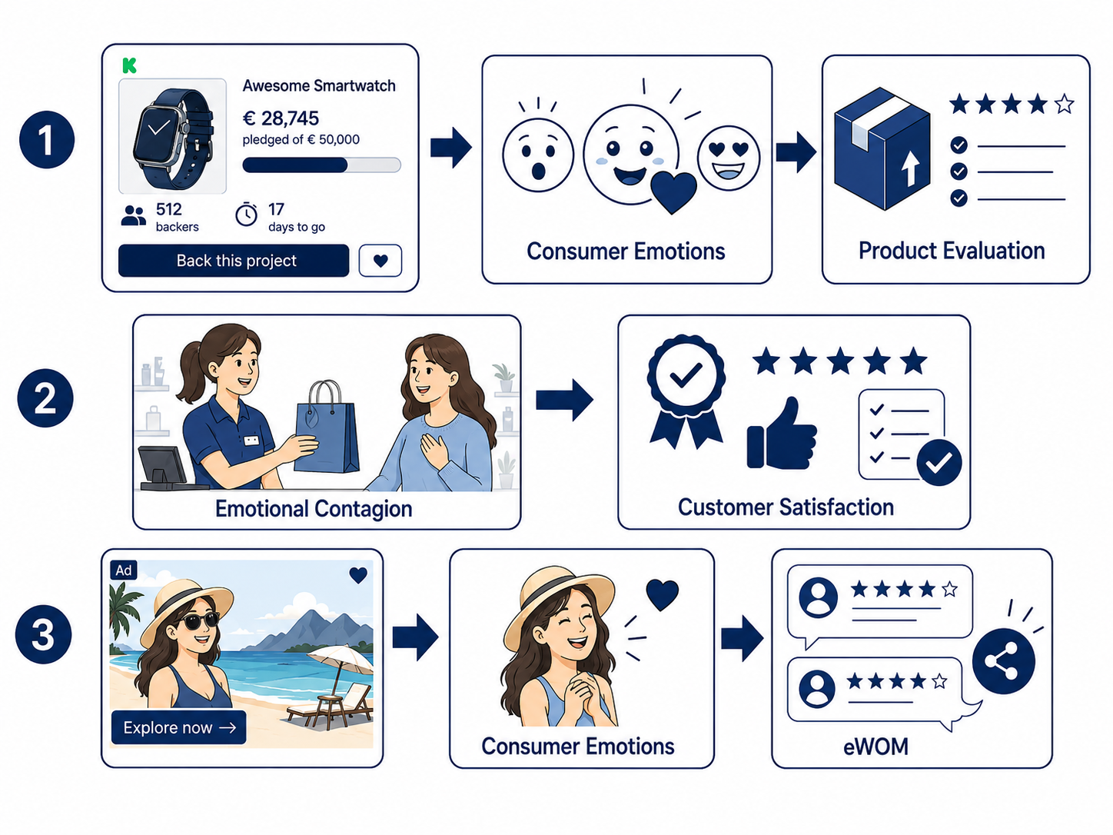
Research Snapshots

Slide 6

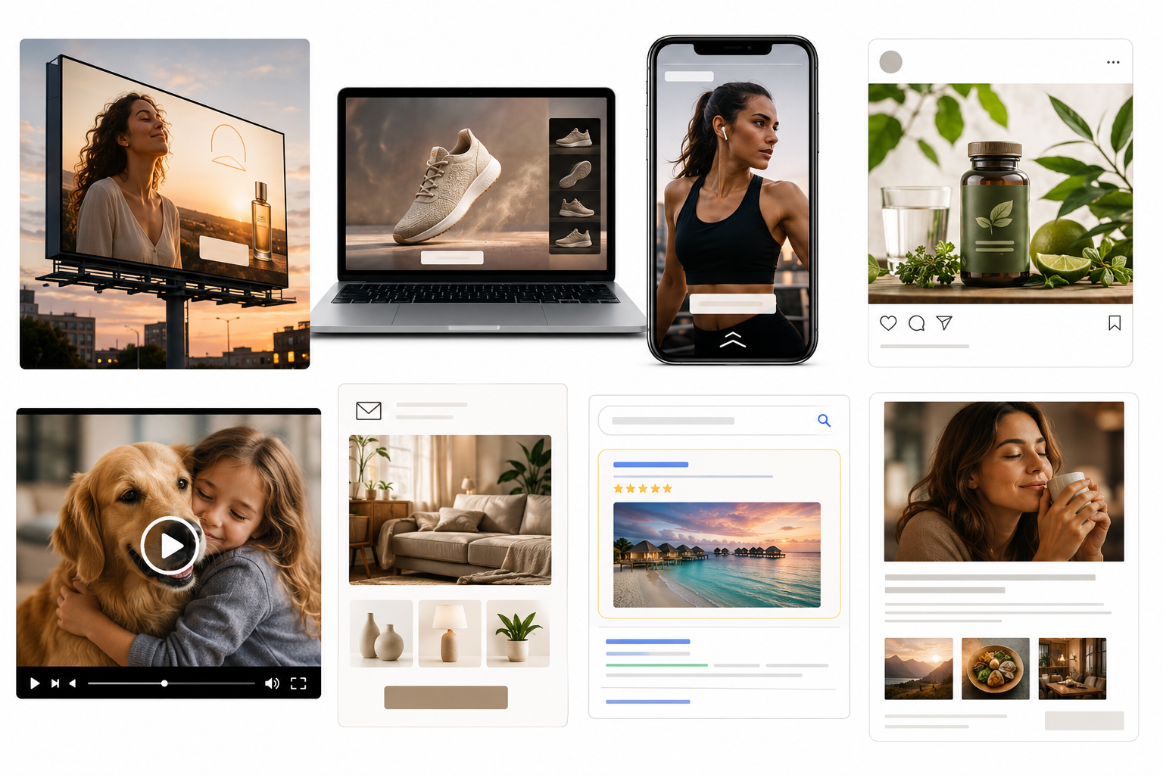
The Power of Emotions Along the Customer Journey
THE FUZZY MIDDLE?!

Slide 7

The Return on Emotions
Return on Emotions

Slide 8

Unvealing „the Hidden“

Slide 9
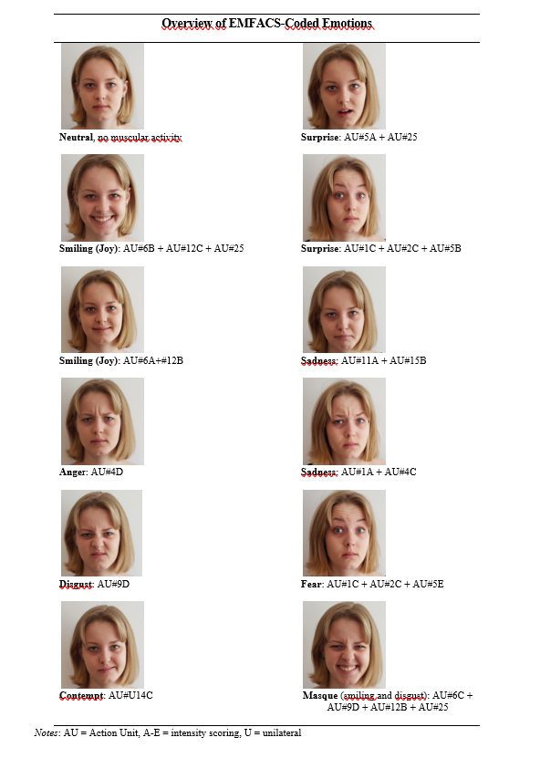
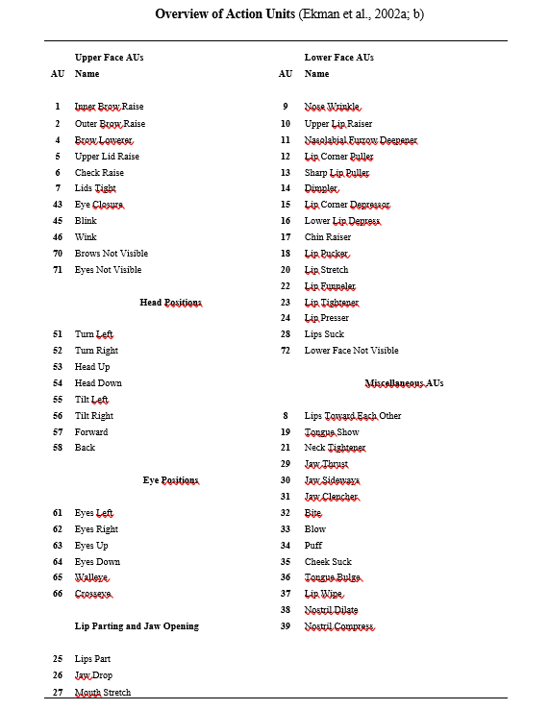
Manual Coding
Time-consuming
Hofmann, V., Stokburger‐Sauer, N. E., & Wetzels, M. (2024). The role of a smile in customer–employee interactions: Primitive emotional contagion and its boundary conditions. Psychology & Marketing, 1–16. https://doi.org/10.1002/mar.22047

Slide 10
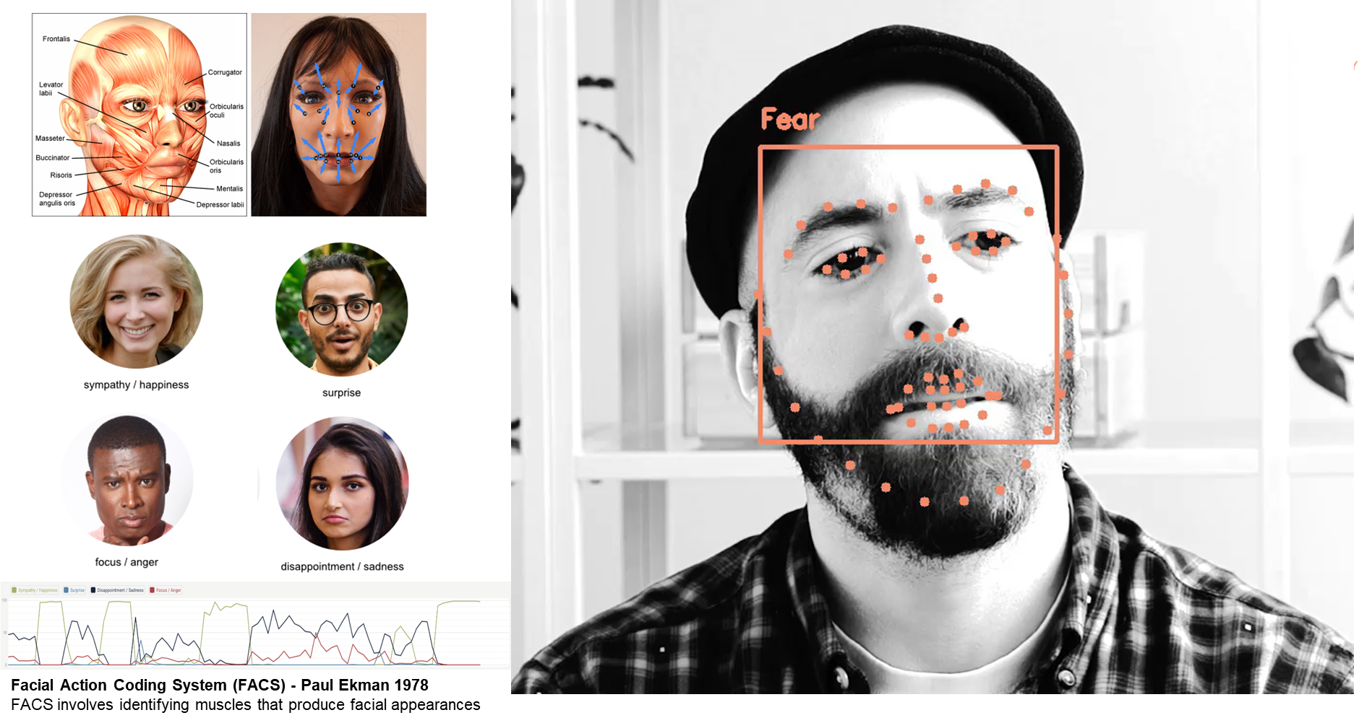
AI-Based Coding (1)

Slide 11
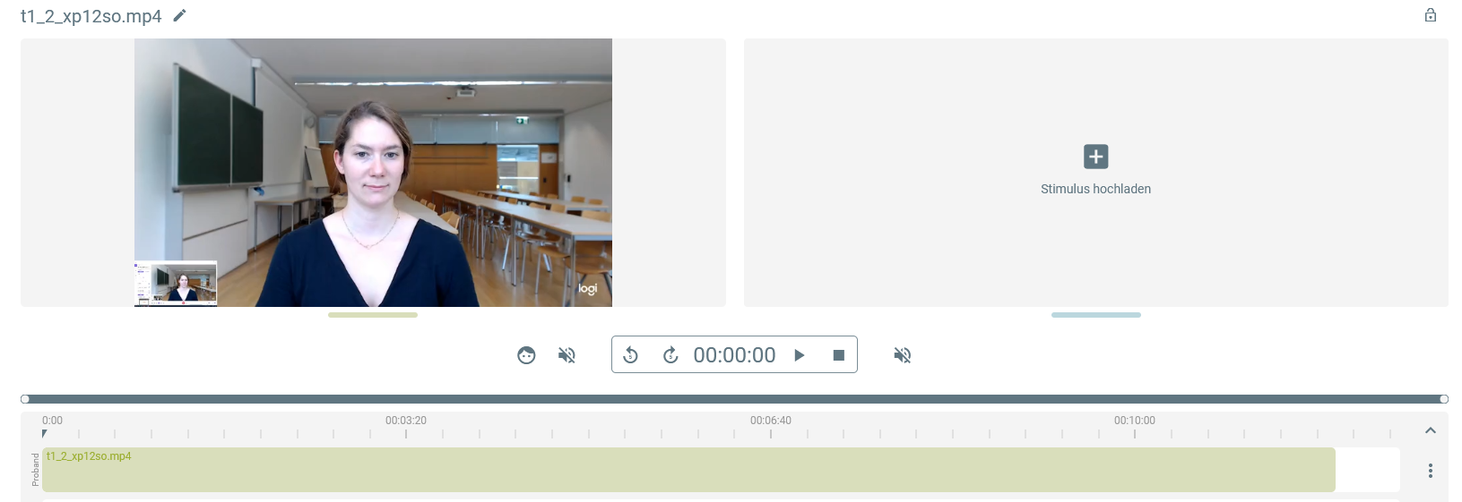

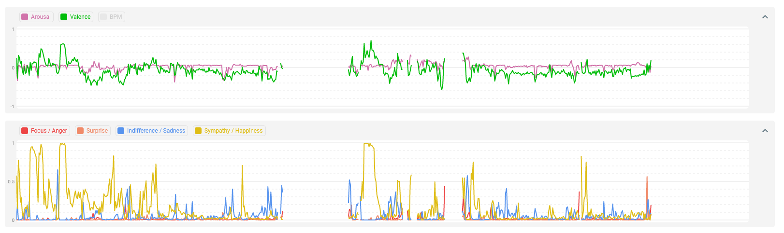
AI-Based Coding (2)
Prof. Dr. Nicola Stokburger-Sauer, Dr. Verena Hofmann, Janina Kuhnle, MSc, Heike Hebborn, MSc
FWF :P 33268-GBL

Slide 12
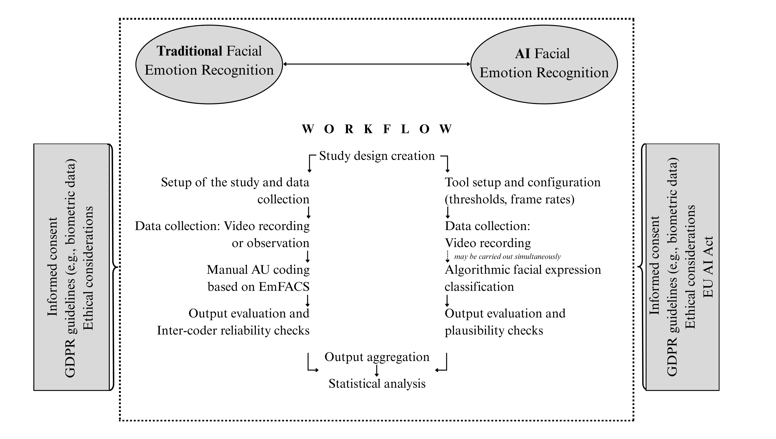

Comparison

Slide 13
2
The Role and Success of AI-Generated Content in Advertising

Slide 14

AI-Generated Content (1)

Slide 15

AI-Generated Content (2)
Views
EU AI Act:
Labelling Obligation
Conver-sions
Clicks

Slide 16
The Power of Hidden AI-Generated Content

Slide 17
Summary
1
Return on Emotions as relevant measure
2
Use the power of unconscious emotions and AI-based measurement
3
Cleverly choose AI-based content

Slide 19

THANK YOU

Slide 20


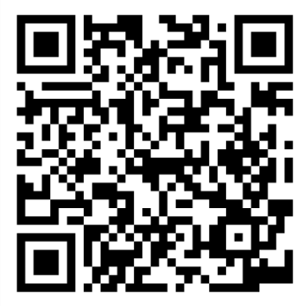
Verena.Hofmann@fom.de
https://www.researchgate.net/profile/Verena-Hofmann-3
https://at.linkedin.com/in/verena-hofmann-102881201

