Slide 1


KEYNOTE
Reimagining hotel & flight
search for the agentic era.
Kirill Lukesch
Head of Data & Co-Head of Product, Zenvoya

Slide 2

ABOUT ME
Kirill Lukesch
Head of Data & Co-Head of Product, Zenvoya
3M+
40M+
1st-party
properties cleaned
flights analyzed
data & intent stack
I own the data and personalization behind what every traveler sees.

Slide 3
THE PROBLEM
You can’t put a smart assistant
on a broken foundation.
Free parking
Self parking
Valet parking
Parking garage
Garbage in, garbage out
No personalization
Hallucination
28
80%
24%
ways to write ‘parking’
browse the map, not the form
trust AI travel recommendations
Sources: Zenvoya supplier data · Airbnb, 2024 · Wunderkind × Skift, 2026

Slide 4




THE SOLUTION
Four layers to search that finally works.
Data Hygiene
Grounding
NLU
Personalization
Zenvoya
zenvoya.ai

Slide 5
DATA HYGIENE
One amenity, dozens of names.
Parking garage
Free parking
Valet parking
647 → 266
Self parking
✓ Parking
On-site parking
Paid parking
28 strings → 1 concept
Street parking
canonical amenity concepts
Parking
across 3.1M properties
Zenvoya
zenvoya.ai

Slide 6
DATA HYGIENE
Cleaned across every field.
Amenities
Room amenities
Property types
Bed types
Brands
647 → 266
1,044 → 106
76 → 44
22 → 13
4,173 → 4,927
canonical concepts
canonical concepts
canonical concepts
canonical concepts
structured into 162 groups
RAW SUPPLIER RECORD
CANONICAL RECORD
amenities
“Free WiFi”, “Free wired internet”
amenities
Internet access
property type
“Hostel”, “Hostel/Backpacker accommodation”
property type
Hostel
bed type
“King bed”, “Large bed(s) (King size)”
bed type
King
Zenvoya
zenvoya.ai

Slide 7
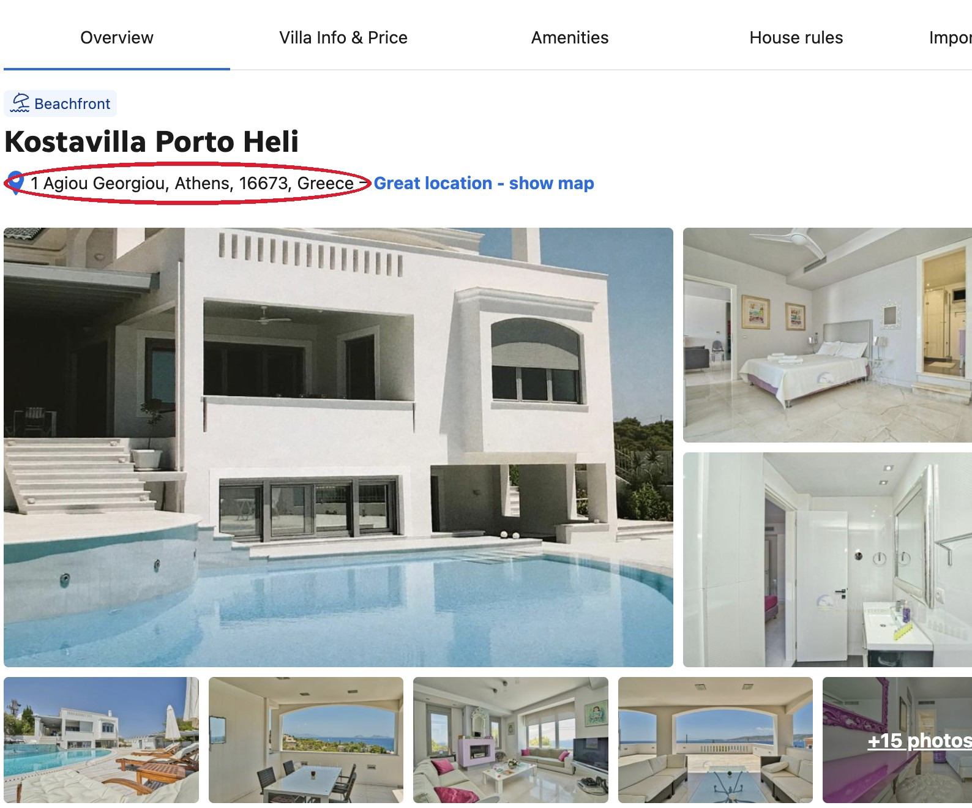
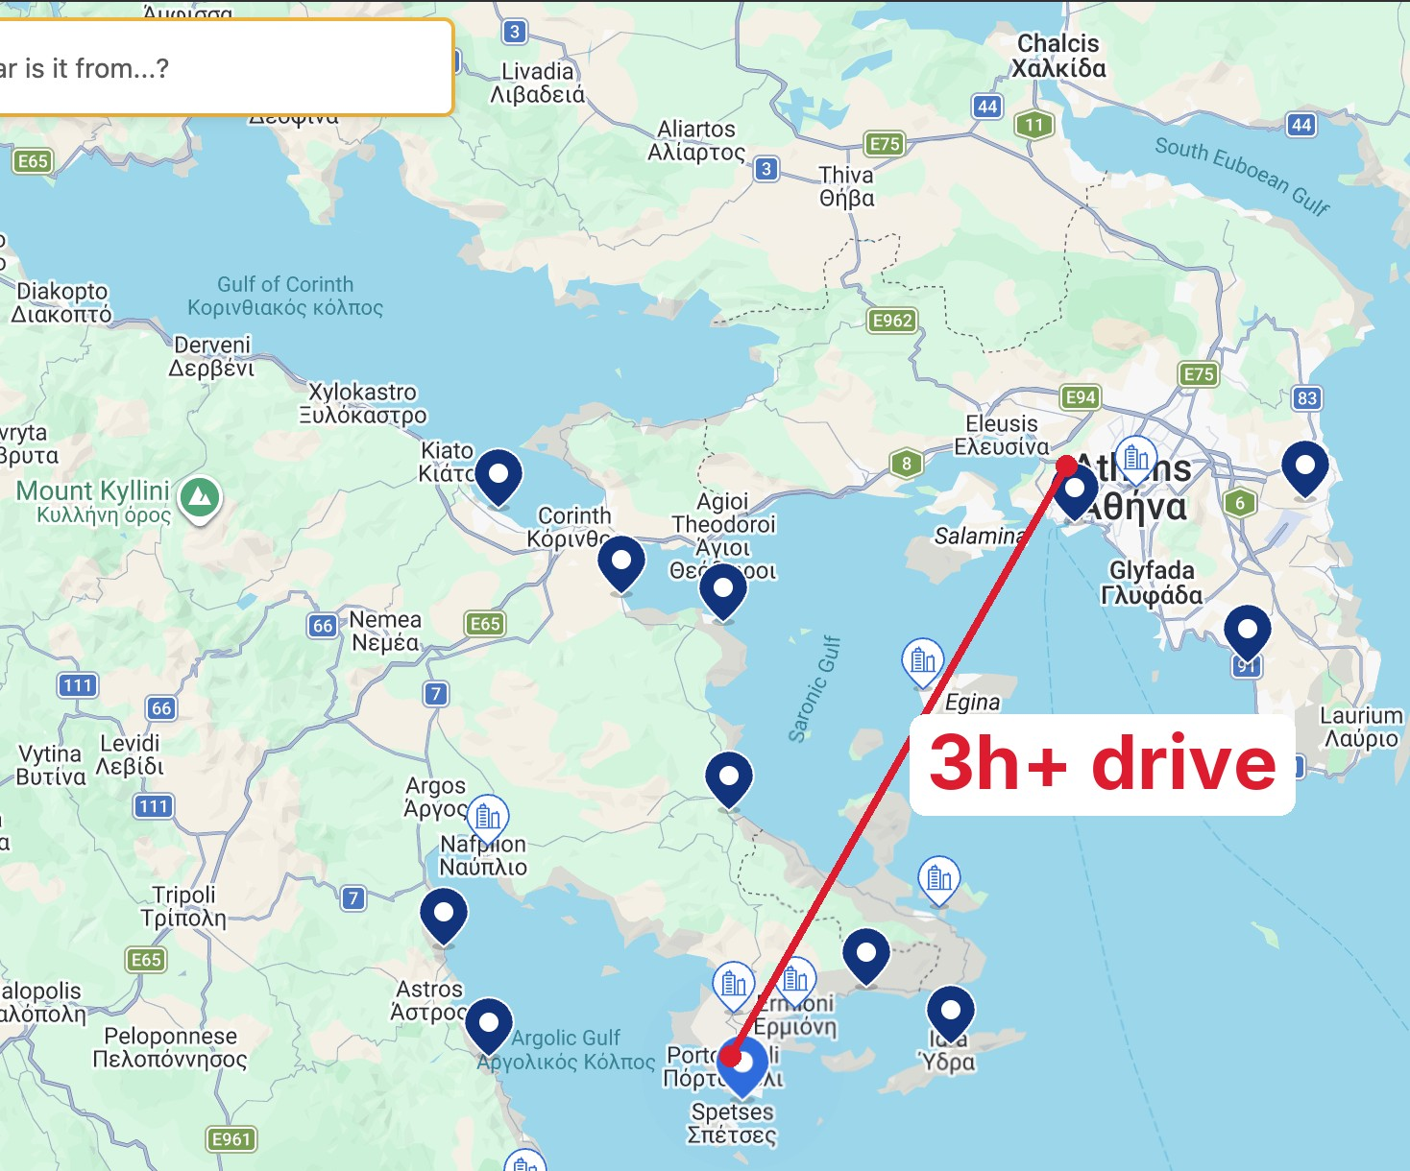
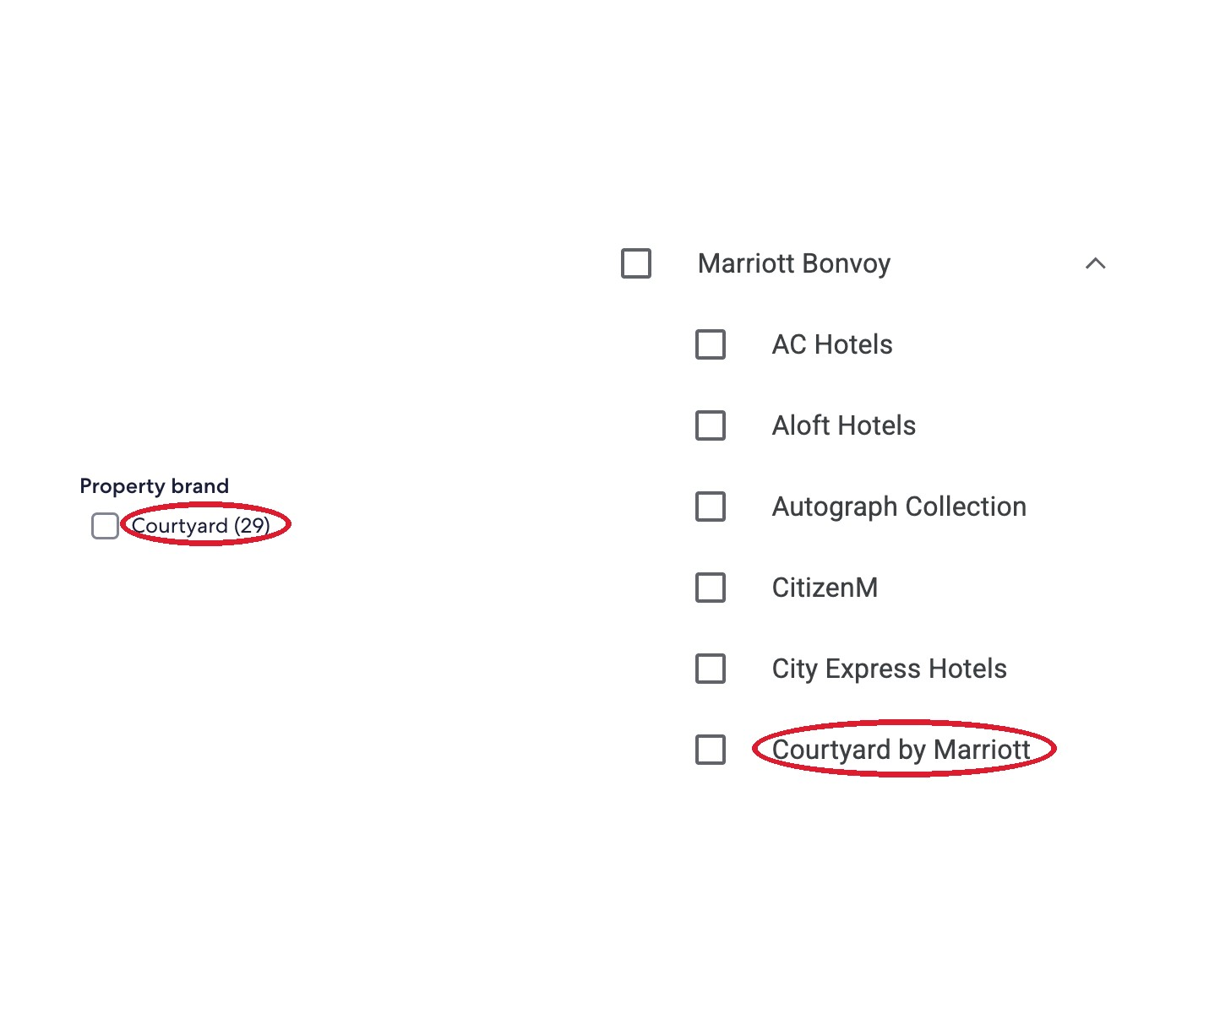
DATA HYGIENE
Industry-wide data rot.
Listed in Athens.
Actually in Porto Heli.
Same brand, two names.
Zenvoya
zenvoya.ai

Slide 8



DATA HYGIENE
It cleans itself.
?
“Undercover parking”
A new term appears
Human + AI propose
the canonical mapping
Folded into the lookup table
self-healing · new cases handled every day
Zenvoya
zenvoya.ai

Slide 9

GROUNDING
Rigorous hallucination guards.
RAG-LOOKUP
Static flight data
✓
Static hotel data
Query
Static activity data
Grounded answer
The LLM never emits a number or a place it can't cite.
Zenvoya
zenvoya.ai

Slide 10
GROUNDING
How the corpus is built.
10+ Sources
Ingestion & Parsing
Semantic retrieval
Enrichment & Normalization
Regularly refreshed, vetted and performant semantic retrieval. Never stale.
Zenvoya
zenvoya.ai

Slide 11
GROUNDING
Grounded in data we own.
3.1M
13.7M
~20M
Hotels
Rooms
Activities
Cleaned and curated data built for scale.
Zenvoya
zenvoya.ai

Slide 12
NLU
We read what you mean.
“
Find me a 4-city trip in Business class starting EWR to NRT on Oct 1, then NRT to SIN on Oct 8, then SIN to DXB on Oct 15, then DXB to JFK on Oct 22. I want everything on Star Alliance carriers, ANA, Singapore Airlines, or United are ideal. Budget around $10,000 total.
Natural language becomes hard filters and weighted preferences.
Zenvoya
zenvoya.ai

Slide 13

NLU
Filters lock, preferences rank.
HARD FILTERS
Route + dates
Business class
WEIGHTED PREFERENCES
1 → 5
Around $10,000 total
4
target
Star Alliance
4
strong
ANA, Singapore, United ‘ideal’
3
preferred
Zenvoya
zenvoya.ai

Slide 14
NLU
Ranked by fit, not filtered out.
FIT
Flight A ANA · Business · Star Alliance
$10,200
#1 best fit
Flight B Mixed alliance · Business
$9,700
#2
A hard $10,000 filter would delete Flight A. Preferences keep it first.
Zenvoya
zenvoya.ai

Slide 15
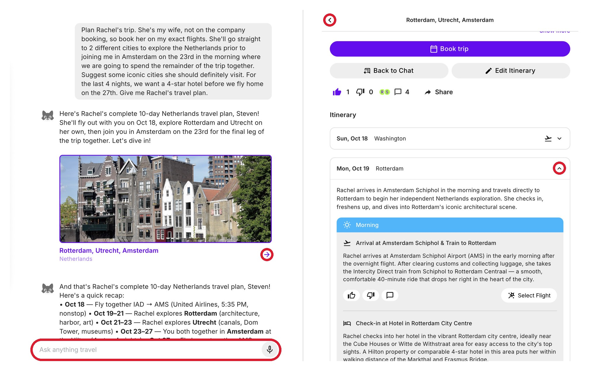
PERSONALIZATION
Everything is data.
Every search, tap, dwell, chat and skip is a signal.
Zenvoya
zenvoya.ai

Slide 16
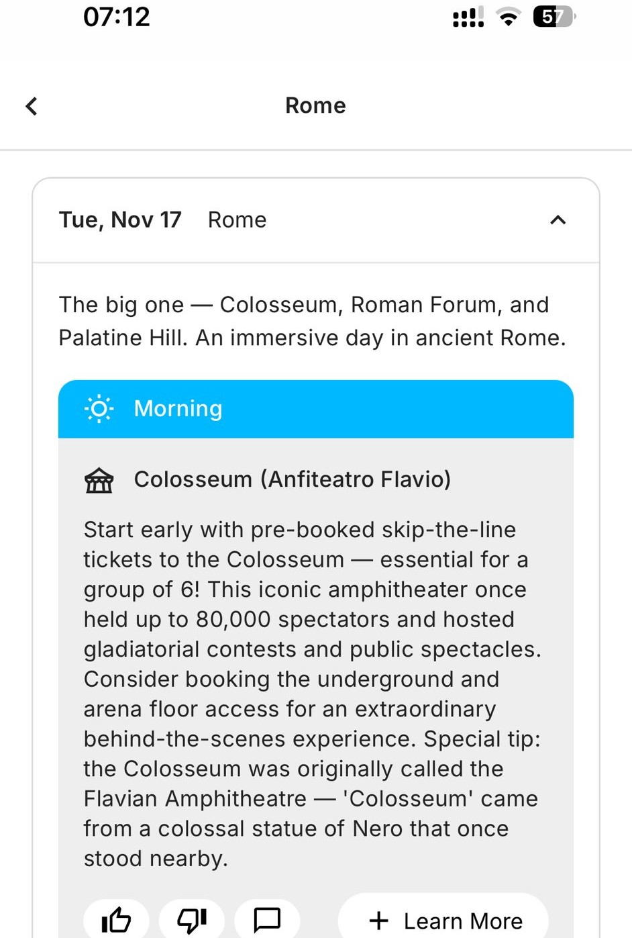
PERSONALIZATION
Silence is a signal.
They opened it.
Then they left.
No tap. No save. No booking.
The silence is the signal: this trip missed.
Zenvoya
zenvoya.ai

Slide 17
PERSONALIZATION
You become a vector.
Everything you say and do, scored on real, named axes.
Social intensity
Sensory load
Cultural density
Pace
Vibe · cozy
Vibe · romantic
your preference vector
Zenvoya
zenvoya.ai

Slide 18
PERSONALIZATION
The same axes as every place.
You
Social intensity
RANKED FOR YOU
Sensory load
94%
Intimate wine bar
Cultural density
Pace
89%
Candlelit bistro
Vibe · cozy
82%
Jazz lounge
Vibe · romantic
Zenvoya
zenvoya.ai

Slide 19

IN SUMMARY
Data Hygiene
Grounding
NLU
Personalization
Search that finally understands
the traveler.

