Slide 1

Building Production-Ready AI Systems
Practical patterns for enterprise AI that survives contact with production
Eshaan Jain | MunichTech EXPO, Munich | 20–21 September 2026

Slide 2

About the Speaker
Role
T-Mobile Impact
Lead Product Owner, Salesforce / Vlocity CPQ at T-Mobile, employed by Mphasis
Leading Salesforce CPQ and CLM transformation, cutting contract creation time 50%
Experience
Recognition
15+ years across Amazon, T-Mobile, PwC, and Accenture in enterprise AI, applied ML, and agentic system design
IEEE Senior Member, Forbes Technology Council member, 55+ citations across IEEE and Elsevier publications
Amazon Achievement
Why I'm Here
Built an ML clause extraction system that hit 95% accuracy across a $40B annual contract portfolio
Here to share what breaks when AI systems leave the demo and what it takes to fix it
Eshaan Jain | Contracts. Intelligence. Scale.

Slide 3




Why This Talk
The Demo
Most AI conference talks show what a system can do in a demo
The Gap
Fewer show what it takes to keep that system running when real users, real data, and real failure modes show up
Production
This talk covers the second part: production. General patterns, generalized across industries. No product pitch, no proprietary case study numbers
Eshaan Jain | Contracts. Intelligence. Scale.

Slide 4
What We'll Cover
What "production-ready" actually means
The 5 layers every production AI system needs
Where AI systems break in production
Beyond a working demo
Data, models, orchestration, reliability, and observability
And why
A checklist you can use
Where this is headed
Practical and actionable
Over the next 12 to 24 months
Eshaan Jain | Contracts. Intelligence. Scale.

Slide 5

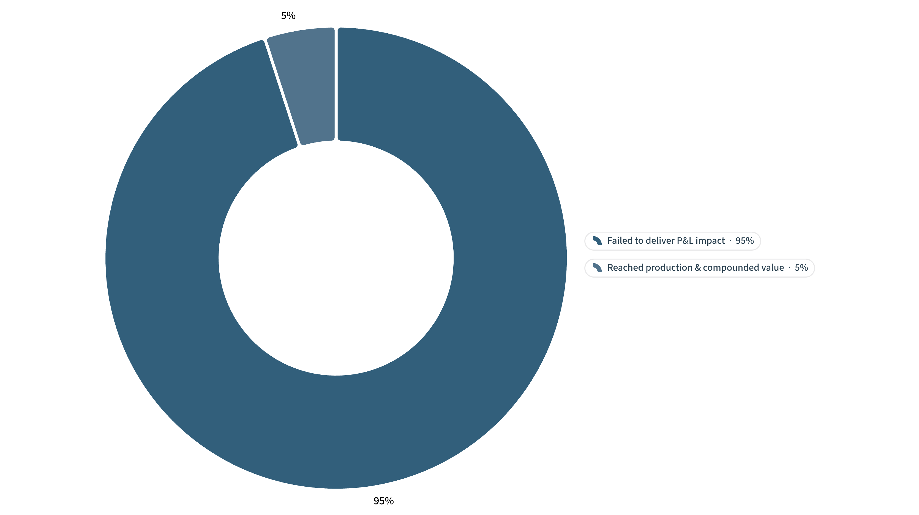
The Gap Between Demo and Deployment
95%
300+
Failure Rate
Deployments Studied
Enterprise GenAI deployments that failed to deliver measurable P&L impact
MIT NANDA studied over 300 enterprise generative AI deployments in 2025
Source: MIT NANDA, "The GenAI Divide: State of AI in Business 2025"
The report names this the "GenAI Divide": most pilots stall,
a small number reach production and compound in value.
The systems that succeeded shared a pattern: built and owned
by the teams closest to the workflow, with tight feedback loops,
not handed off from a central AI lab.
Eshaan Jain | Contracts. Intelligence. Scale.

Slide 6
What "Production-Ready" Means
A working demo proves the model can produce a correct answer once, under conditions you controlled. A production-ready system holds up against 5 tests, every time, under conditions you don't control.
Reliability
Observability
Security
Predictable behavior under load, safe failure when something breaks
You can see what the system did and why, after the fact
Resists prompt injection, data leakage, and unauthorized actions
Cost Control
Governance
You know the cost per request, and it doesn't scale linearly with usage
Someone owns the decision, can explain it, and can be held accountable for it
Eshaan Jain | Contracts. Intelligence. Scale.

Slide 7

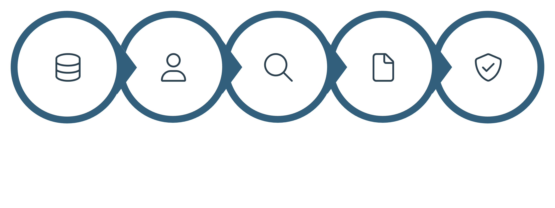
LAYER 1 OF 5
Layer 1: Data Foundations
Data
Models
Retrieval
Orchestration
Reliability
Root cause of every production AI failure
Build a golden dataset first
The unglamorous truth
Every production AI failure I've traced back far enough lands on the same root cause: unstructured, inconsistent, or poorly governed data
Build a golden dataset before you build a prompt. If you can't define 50 to 100 correct answers by hand, the task isn't understood well enough to automate
Data quality work is unglamorous and underfunded. It decides whether everything downstream works
The data is rarely clean
Clause extraction, contract data, product catalogs, support tickets: the data feeding the model is rarely clean when a project starts
3 questions before you pick a model
Where does the ground truth live, who owns it, and how do you know when it changes
Eshaan Jain | Contracts. Intelligence. Scale.

Slide 8

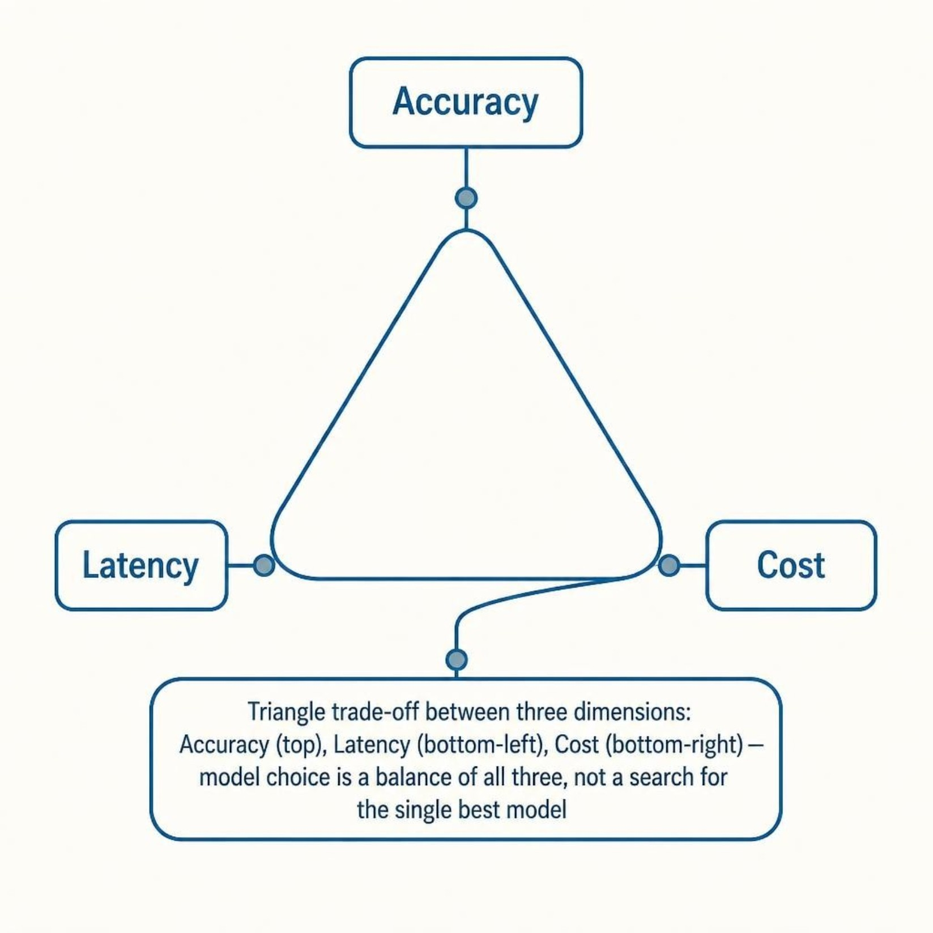
LAYER 2 OF 5
Layer 2: Model Selection and Evaluation
Layer 1 Data
Layer 2 Models
Collect and prepare high-quality datasets for evaluation.
Select and evaluate models against the golden dataset.
Layer 3 Retrieval
Layer 4 Orchestration
Fetch relevant context to support model responses in real time.
Route data and models, coordinating multi-step workflows.
Run every candidate against the golden dataset
Before committing. Automated evaluation catches regressions, human evaluation catches the errors automated evaluation misses
Build the evaluation suite before you need it
Adding evaluation to a system already in production is slower and more expensive than building it first
Route by task, not by preference
Simple classification doesn't need the same model as multi-step reasoning
Re-run the evaluation suite on every model update
A silent update can change behavior overnight
Eshaan Jain | Contracts. Intelligence. Scale.

Slide 9
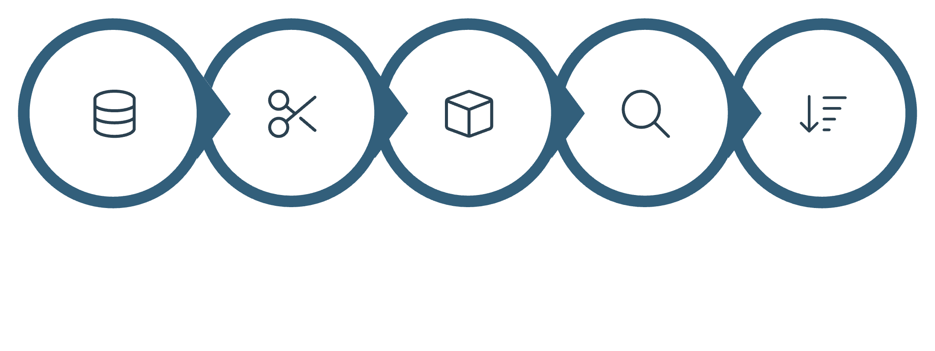
LAYER 3 OF 5
Layer 3: Retrieval and Context Engineering
Layer 1 Data
Layer 2 Models
Collect and chunk semantic units for retrieval.
Apply models that consume contextualized data inputs.
Most "model failures" are context failures
The model never saw the information it needed
Chunk by semantic unit
A clause, a ticket, a product record — not by fixed
token count
Retrieval quality beats retrieval quantity
Adding context past the point of relevance adds noise
and cost, not accuracy
Layer 3 Retrieval
Layer 4 Orchestration
Test retrieval and generation separately
Teal-highlighted: fetch precise context for queries.
Coordinate models and retrieval across pipeline.
If retrieval returns the wrong document, no amount of
prompt engineering fixes the answer
Version prompts and retrieval logic like code
Both change behavior
Corpus
Semantic Chunking
Vector Index
Query
Ranked Context
Eshaan Jain | Contracts. Intelligence. Scale.

Slide 10
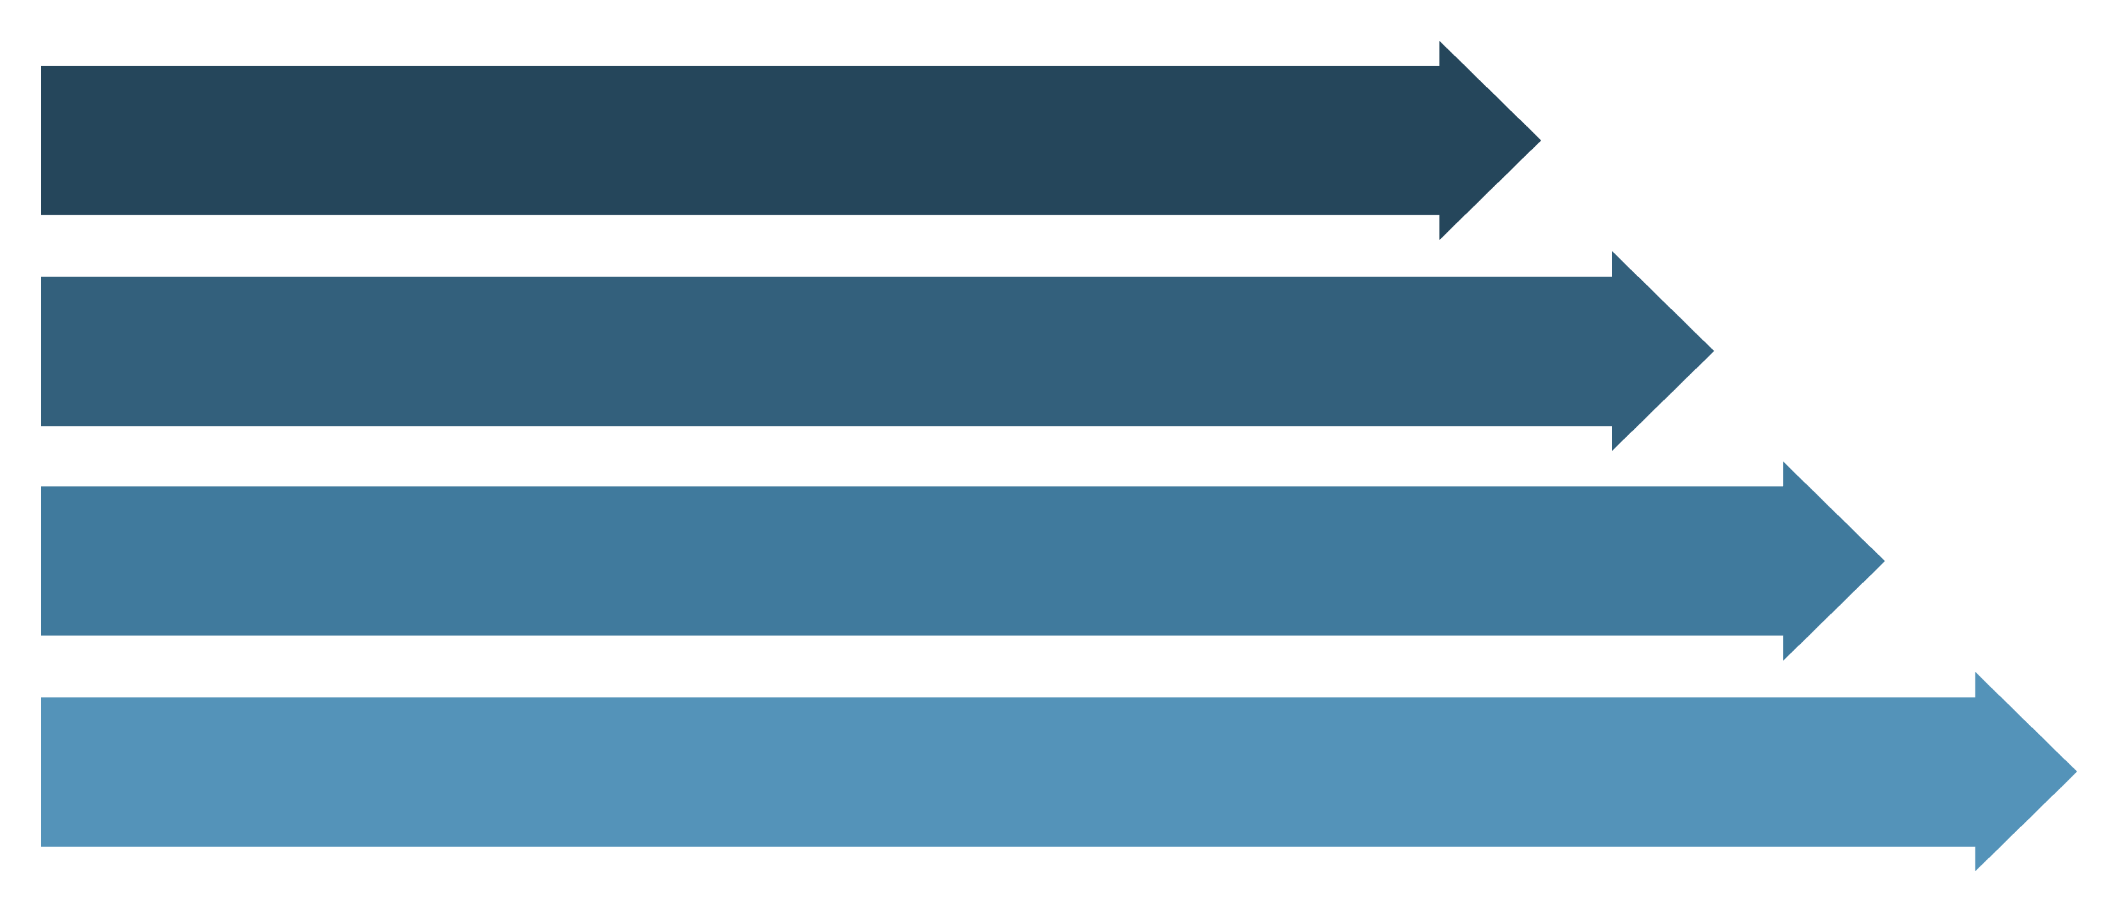
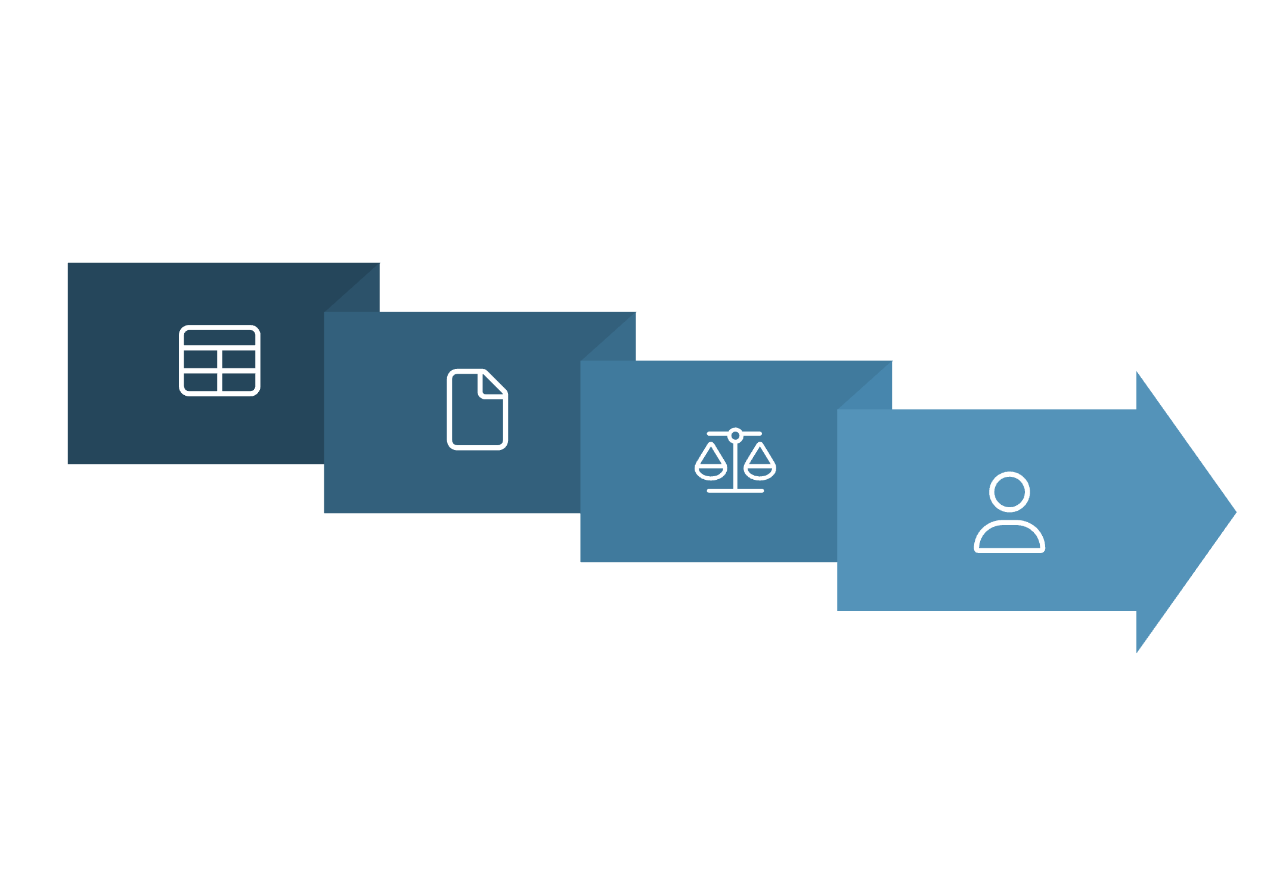
LAYER 4 OF 5
Layer 4: Agent and Multi-Agent Orchestration
Layer 1: Data
Layer 2: Models
Layer 3: Retrieval
Layer 4: Orchestration
A single well-scoped agent outperforms
premature multi-agent
Handoff Format
Add a second agent only when one agent is doing two
genuinely different jobs
Orchestrator
Give every agent a narrow, named responsibility
And a defined handoff format. Vague responsibilities
produce vague failures
Orchestration needs its own error handling
Agent A
When one agent in a chain fails, decide in advance whether
the chain retries, escalates to a human, or fails the task
Agent B
Multi-agent systems multiply the evaluation surface
Test the handoffs, not just the individual agents
Eshaan Jain | Contracts. Intelligence. Scale.

Slide 11
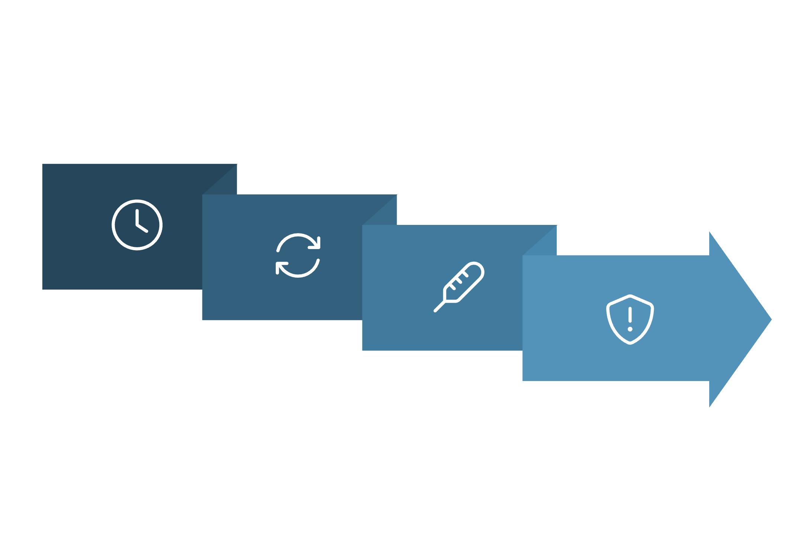
LAYER 5 OF 5
Layer 5: Reliability for Non-Deterministic Systems
Layer 1 Data
Layer 2 Models
AI systems are non-deterministic by design
Foundational inputs that feed subsequent models.
Train and generalize patterns from raw data.
Traditional software reliability assumes the same input produces the same output. AI systems don't work that way, and the design has to account for it
Retry with variation, not repetition
Adjusting the prompt slightly or lowering temperature on
retry catches more failures than an identical retry
Layer 3 Retrieval
Layer 4 Orchestration
Hard timeout and fallback on every model call
A hung request is worse than a wrong one
Fetch relevant context to inform model responses.
Coordinate flows and decision logic across components.
Circuit-break on repeated failures
If a downstream model or tool fails 3 times in a row,
stop calling it and surface a clear error instead of degrading silently
Retry: prompt tweak
Define graceful degraadation before it ships
Circuit open → Fallback
Not while it's failing in front of a customer
Call (timeout)
Retry: lower temp
Eshaan Jain | Contracts. Intelligence. Scale.

Slide 12
Guardrails and Validation
Validate model output like user input
Separate say from do
Prompt injection is a tested attack surface
A model can draft an email; it shouldn't send one without a check. Separate what the model is allowed to say from what it is allowed to do
Check type, range, and format before it reaches a downstream system
Treat any text a model reads, including retrieved documents, as untrusted input
Narrow tool access
Red-team before a customer does
An agent with database write access should get the narrowest scope that lets it do its job
Red-team the system before a customer or a researcher does it first
Eshaan Jain | Contracts. Intelligence. Scale.

Slide 13
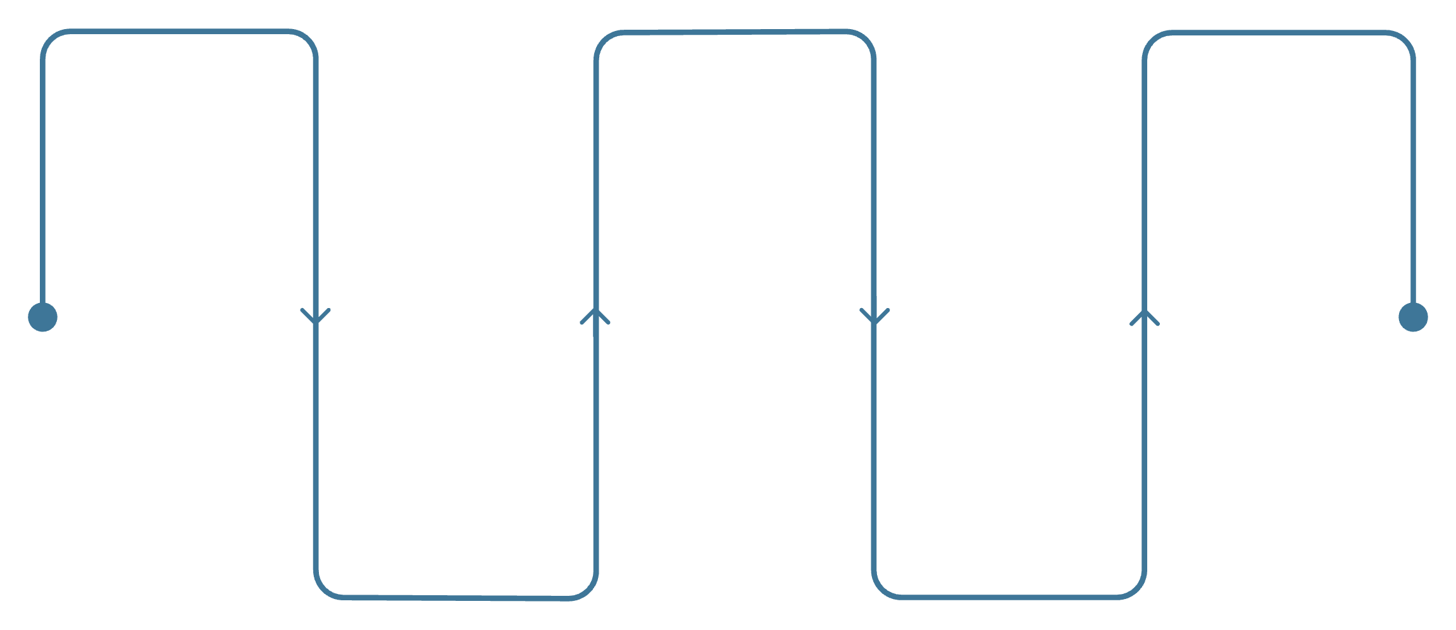
Observability: Logs, Traces, Evals
A system you can't reconstruct is a system you can't debug
Log the full chain: input, retrieved context, model output, tool calls, and final response, tied to a single trace ID
User Input
Model Output
Final Response
Track evaluation metrics in production
Raw query or prompt
Generated response draft
Delivered to user with Trace ID
Not only at launch. Accuracy measured once in a demo says nothing about accuracy in month 6
Set alerts on drift
Retrieved Context
Tool Calls
Rising latency, rising cost per request, or a falling pass rate on the automated evaluation suite
Relevant documents & data
External APIs and actions
Sample real production outputs weekly
Dashboards show trends; sampling shows what actually happened
Eshaan Jain | Contracts. Intelligence. Scale.

Slide 14
Token Economics and Cost Control
Cost-per-inference is infrastructure economics
Measure cost per completed task
Cache aggressively
Not cost per API call. A cheap call that needs 3 retries costs more than an expensive call that succeeds once
Repeated or near-duplicate queries don't need a fresh model call every time
It decides which AI programs survive past their pilot budget
Right-size the model to the task
Track CO₂ and energy cost
A smaller, faster model for classification and routing, a larger model reserved for the step that needs it
Alongside dollar cost where the organization reports on it. It's becoming a procurement question, not only a sustainability one
Eshaan Jain | Contracts. Intelligence. Scale.

Slide 15
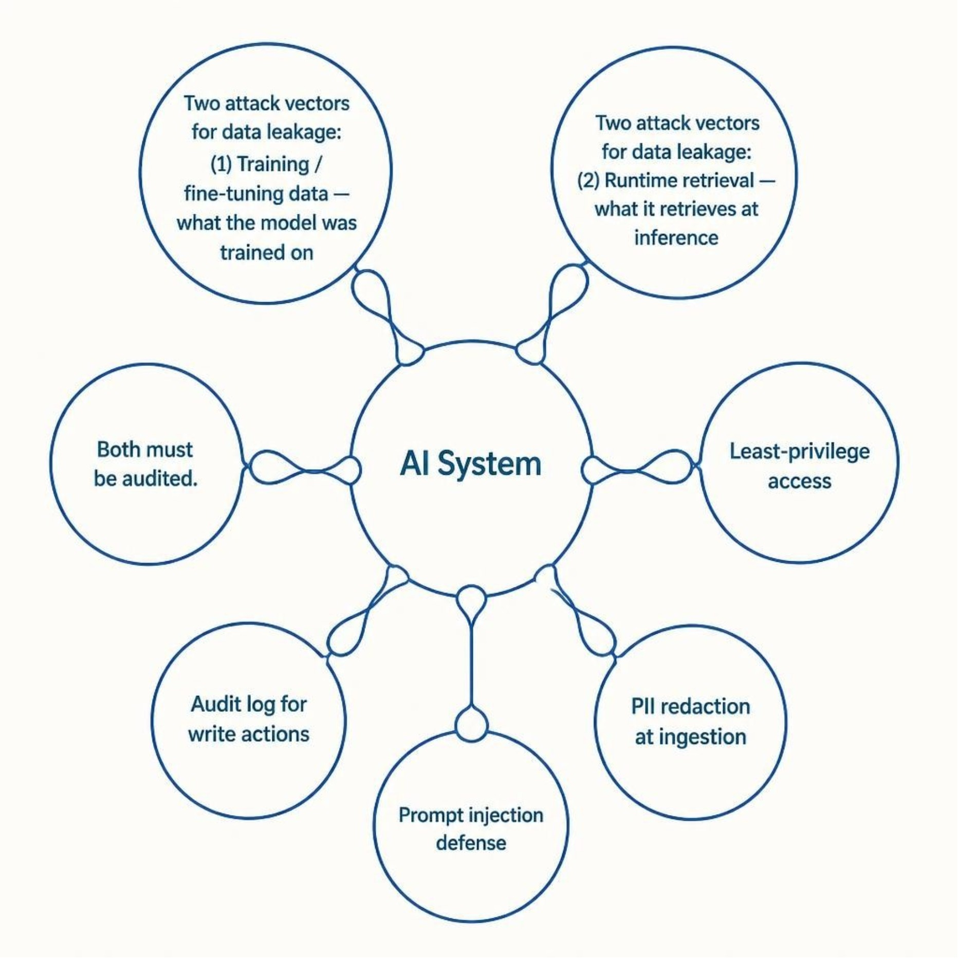
Security for Enterprise AI
An AI system is a new attack surface
Not an extension of existing application security
Data leakage happens two ways
Through what the model was trained or fine-tuned on, and through what it retrieves at runtime. Audit both
Least-privilege applies to agents
The same way it applies to service accounts. An agent should hold only the credentials its task requires
Handle PII before data reaches a model
Redact or tokenize sensitive fields at the ingestion layer, not after
Log every agent action with write access
If something goes wrong, you need to know what it touched and when
Eshaan Jain | Contracts. Intelligence. Scale.

Slide 16
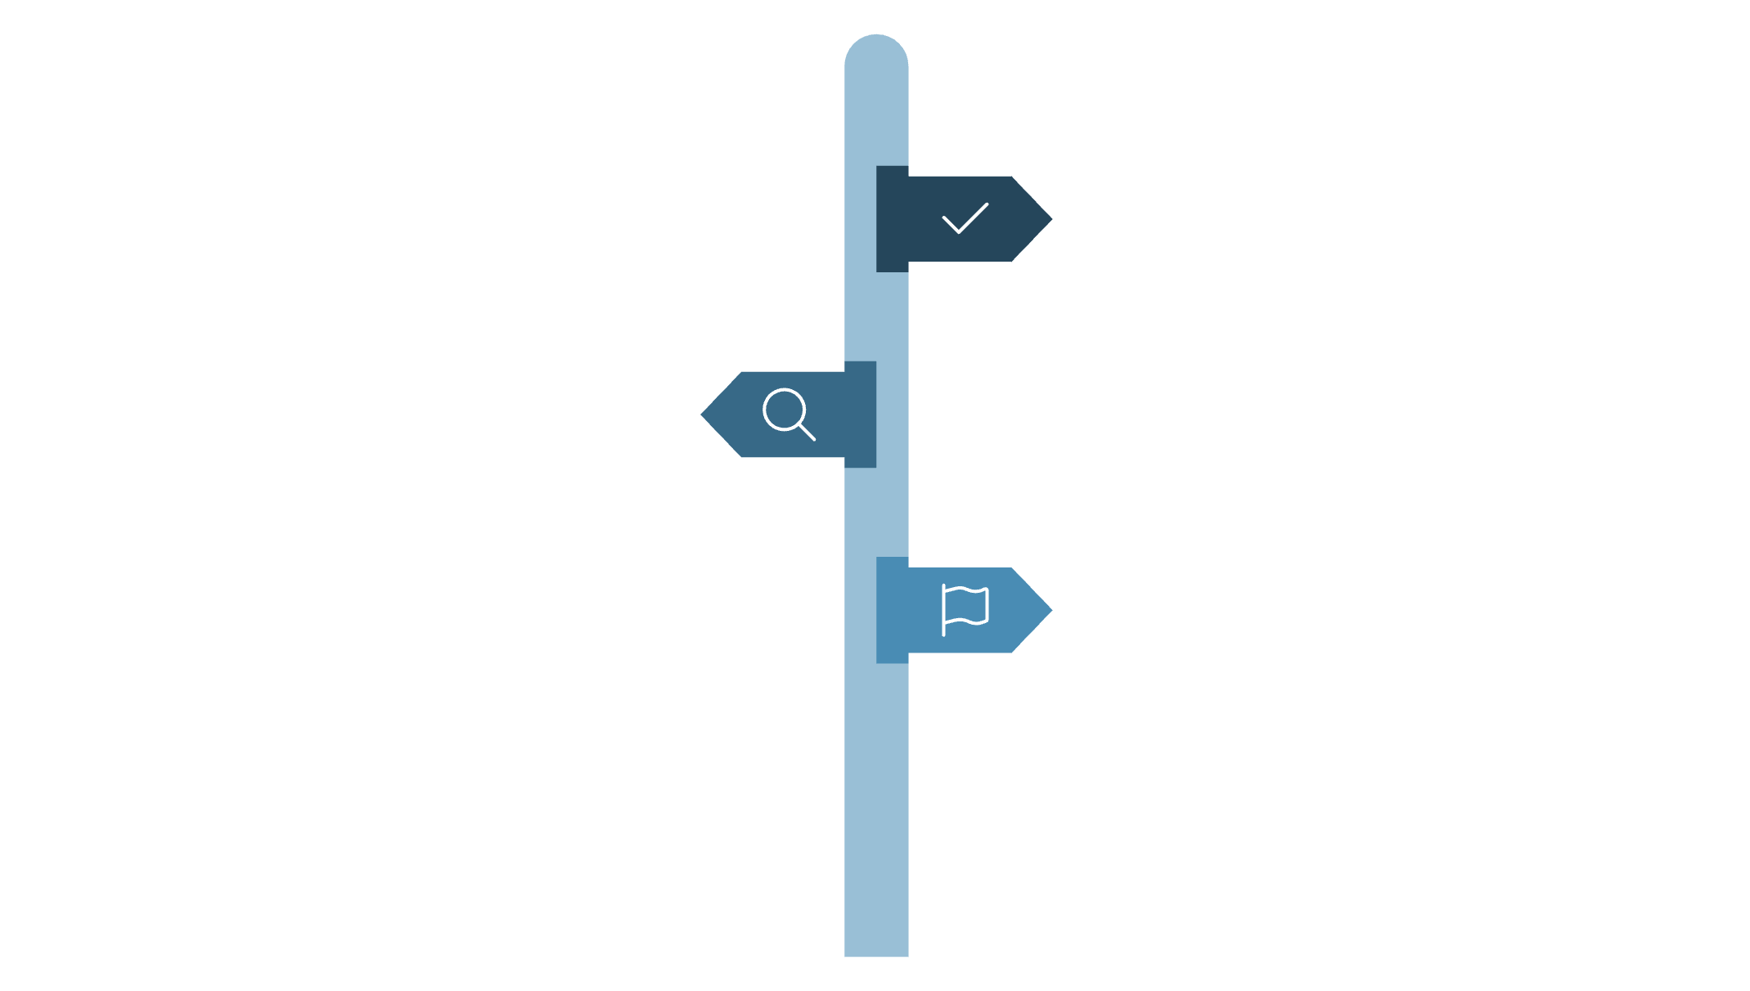
Human-in-the-Loop Design
Decide the review point before building the workflow
Pre-action approval, post-action audit, or exception-only review
Reserve human review for high-cost-of-error decisions
Pre-action Approval
Reviewing everything defeats the purpose of automation; reviewing nothing removes the safety net
Human approves before the model acts.
Post-action Audit
Make the reviewer's job easy
Human reviews outcomes after actions occur.
Show the model's reasoning and its source, not only the final answer
Exception-only Review
Human sees only flagged or risky cases.
Track human override rate over time
A rising override rate is an early warning that something upstream has drifted
Build the feedback loop so corrections improve the system
A human-in-the-loop step that doesn't feed data back is a bottleneck, not a safeguard
Eshaan Jain | Contracts. Intelligence. Scale.

Slide 17
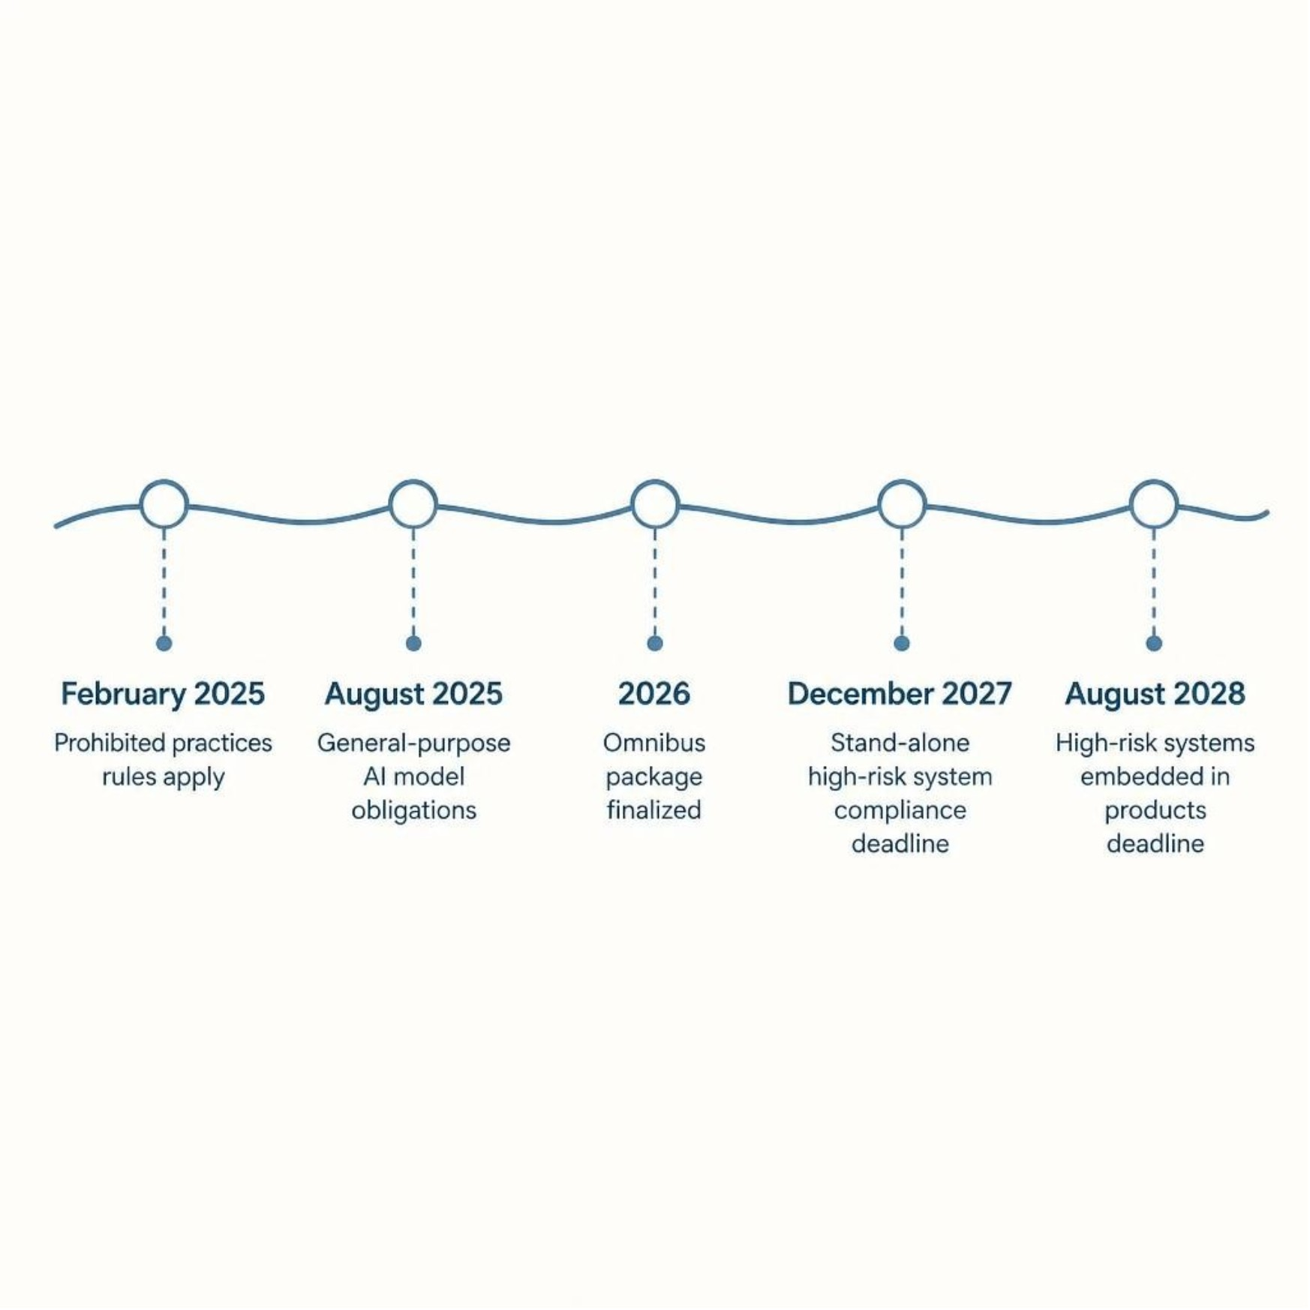
Governance and the Regulatory Picture
Governance answers one question
EU AI Act: prohibited practices
Who is accountable when the system makes a bad call
Applied since February 2025. Obligations for general-purpose AI models since August 2025
Omnibus package (finalized 2026)
A delayed deadline is not a reason to delay the work
High-risk system compliance deadline: December 2027 for stand-alone systems, August 2028 for high-risk systems embedded in products
Risk classification, data governance, and human oversight take longer to build than to document
Build the governance model once, apply globally
Rebuilding it per jurisdiction costs more than building to the strictest standard first
Eshaan Jain | Contracts. Intelligence. Scale.

Slide 18
Common Failure Patterns
Skipping the evaluation suite because the demo looked good
Adding agents to solve a reliability problem
Treating the model as the whole system
More agents multiply failure points; they don't fix a broken single agent
The model is one component; data, retrieval, orchestration, and monitoring are the rest of it
The demo is the easiest version of the problem the system will ever see
No named owner after launch
Tuning for benchmark accuracy instead of task success
AI systems drift, the same way a production database needs a DBA watching it
A model that scores well on a public benchmark can still fail the specific task the business needs
Eshaan Jain | Contracts. Intelligence. Scale.

Slide 19

A Composite Pattern: Pilot to Production
A generalized pattern seen across teams and industries, not a specific company's numbers.
Month 1–2
Month 4
Small team builds a working prototype against a narrow, well-defined task, with a golden dataset of 50 to 100 examples
Limited production rollout to a small user group, with a human review step on every output
1
2
3
4
Month 3
Month 5–6
Team adds retrieval, evaluation, and logging before it adds features. Scope stays narrow
Review rate drops as the evaluation pass rate climbs and trust builds. Scope expands one workflow at a time
The teams that got this far treated the system as something to operate on an ongoing basis, not a project to finish and hand off.
Eshaan Jain | Contracts. Intelligence. Scale.

Slide 20

A Production-Readiness Checklist
Data: is there a golden dataset, and does someone own keeping it current
Observability: can you reconstruct any single request, start to finish, 30 days later
Evaluation: can you run an automated evaluation suite in under an hour, on every change
Cost: do you know the cost per completed task, and does it have a ceiling
Reliability: does every model call have a timeout, a retry policy, and a fallback path
Governance: is there a named owner accountable for the system after launch
Security: have you red-teamed prompt injection and audited what data the model can access
7 questions. If any answer is no, the system isn't production-ready yet. That's fine. Know which one is missing.
Eshaan Jain | Contracts. Intelligence. Scale.

Slide 21
Metrics That Matter
✓
↑
$
Task Success Rate
Human Override Rate
Cost per Completed Task
On real production inputs, not benchmark accuracy on a curated test set
Tracked over time as a leading indicator of drift
Not cost per API call
⏱
★
Time to Detect & Recover
User-Reported Trust
Time to detect a failure, and time to recover from it
Measured directly. A system users route around isn't adopted, whatever the dashboard shows
Eshaan Jain | Contracts. Intelligence. Scale.

Slide 22
Organizational Readiness
Workflow team owns the AI system
Cross-functional fluency over specialist silos
Budget for the unglamorous work
The team that owns the workflow should own the AI system built for it. A central AI lab that hands off a finished model loses the feedback loop that improves it
Teams that ship production AI well speak data, engineering, and the business process well enough to make trade-offs without a translator
Data cleanup, evaluation infrastructure, and ongoing monitoring. It's most of the cost and almost none of the announcement
Set the review cadence before launch
Plan for the system's second year
Who looks at production outputs, how often, and what they're allowed to change
Not only its launch. Most of the real cost and most of the real value show up after the first 90 days
Eshaan Jain | Contracts. Intelligence. Scale.

Slide 23

Where Production AI Is Headed Next
Evaluation infrastructure as standard as CI/CD
Cost and energy accounting moves up the stack
Regulatory definitions converging slowly
Expect evaluation-as-a-service and golden-dataset tooling to mature fast over the next 2 years
From an engineering concern to a procurement and board-level question
Even as specific deadlines shift, risk classification and human oversight definitions are aligning
Multi-agent systems get simpler interfaces first
Advantage moves to teams with clean data
The current work is making orchestration debuggable, not making agents smarter
The model layer is commoditizing faster than the data layer
Eshaan Jain | Contracts. Intelligence. Scale.

Slide 24
Key Takeaways
1
Production-ready means reliable, observable, secure, cost-controlled, and governed
A correct demo answer is table stakes, not the finish line
2
Data quality decides more outcomes than model choice
Every production AI failure traces back to the data layer
3
Build the evaluation suite before you need it
Not after something breaks
4
Add complexity only when a single well-scoped component can't do the job
Including agents
5
Someone needs to own the system after launch
AI systems drift; they don't run themselves
Eshaan Jain | Contracts. Intelligence. Scale.

Slide 25


Thank You
Eshaan Jain
MunichTech EXPO, Munich, 2026
Connect
LinkedIn
Twitter / X
linkedin.com/in/eshaanjain26
x.com/eshaanjain26
Substack
Medium
substack.com/@eshaanjain
medium.com/@eshaanjain26

