Slide 1

CHOICE THEORY FOR ENGINEERS
Technical coaching is missing Link in engineering performance
Speak up? Say no? Ask for help? Take the lead? Stay or move?
By the end of today, you'll have one simple tool to pause, understand, and choose with more clarity.
01

Slide 2

A FAMILIAR FEELING
Have you ever
Lost motivation unexpectedly?
Felt invisible despite your achievements?
Avoided difficult conversations?
Felt exhausted after meetings?
Wondered why?
Today, I’d like to show you
these experiences are not random.
03

Slide 3

WHO'S SPEAKING
Saeedeh Soleimani
Senior Semiconductor Engineer | ICF Certified Coach
Physicist by academy
Senior Engineer, Infineon Technologies
ICF-certified career coach
Lived and worked in four countries
Coaches engineers through career change
“My journey taught me something…”
03

Slide 4
TODAY'S ROADMAP
What We'll Cover Today
1
Five needs behind every choice
2
Why we react without thinking
3
A simple 3-step pause tool
4
Real engineering examples
5
Your next action step
04

Slide 5
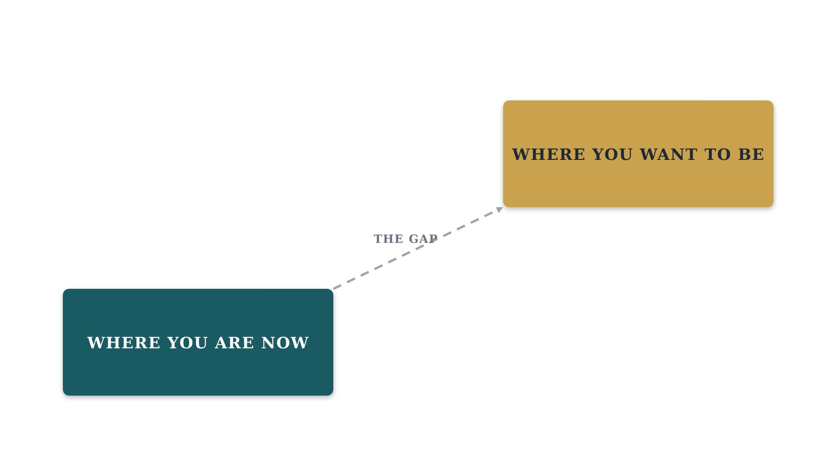
A FAMILIAR MOMENT
Why Good Engineers
Get Stuck
“A tight deadline. A manager checking every detail. You feel irritated — and you don't know why.”
We react to symptoms, not causes
The real driver stays hidden
We end up solving the wrong problem
Frustration repeats without a name
05

Slide 6
THE GOOD NEWS
This Is Learnable
One framework, five needs
No personality test required
Built from 500+ coaching hours
Practical, not just theory
You'll leave with a real tool
06

Slide 7


CHOICE THEORY
Developed by William Glasser: our behavior is purposeful.
Needs
Choices
Actions
Results
We can't control every circumstance — but we can understand the need behind our reaction.
07

Slide 8

💡
NEED 1 OF 5
Survival
WHAT
WHAT
Health, stability, security
Health, workload, security
SIGNAL
Worry about layoffs
ACTION
Talk openly, build skills, plan for your career
08

Slide 9

💡
NEED 2 OF 5
Love & Belonging
WHAT
Connection and trust
SIGNAL
Feeling not included
ACTION
Build one real connection, speak up, invite for coffee
09

Slide 10

💡
NEED 3 OF 5
Power
WHAT
Competence, impact, recognition
SIGNAL
Contribution feels invisible
ACTION
Volunteer for ownership, ask for feedback
10

Slide 11

💡
NEED 4 OF 5
Freedom
WHAT
Autonomy and flexibility
SIGNAL
Micromanaged, no decision room
ACTION
Propose options, agree on check-ins
11

Slide 12

💡
NEED 5 OF 5
Fun
Learning, creativity, curiosity
WHAT
SIGNAL
Work feels repetitive
ACTION
Learn something new or mentor someone
12

Slide 13
LET'S PRACTICE
Let's Practice
Scenario
Your manager criticizes your work.
Which need?
06

Slide 14
THE PRACTICE
Before You React: Pause
1
Understand
Notice the signal: stress, avoidance, tension
2
Name
Which of the five needs is this?
3
Choose
Pick one small action you control
13

Slide 15

IN PRACTICE
A Daily Example
SITUATION
Tight deadline. Manager checks every detail. You feel irritated.
PAUSE
Maybe Freedom is low — or Power, because I don't feel trusted.
ACTION
“I'll send updates on Tuesday and Friday — can I own the technical approach?”
14

Slide 16
ZOOM OUT
Use the Same Lens
for Career Decisions
Survival
Is this role sustainable?
Belonging
Do I feel connected?
Power
Am I growing here?
Freedom
Do I have ownership?
Fun
Am I still curious?
15

Slide 17
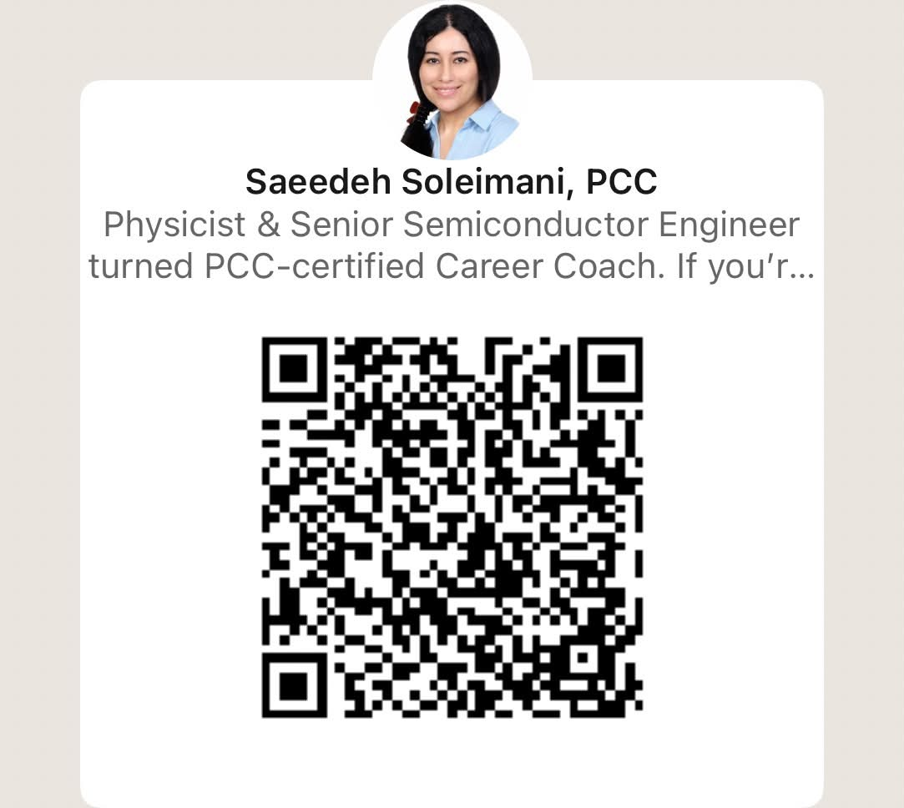
YOUR NEXT STEP
BEFORE YOU GO
Choose one need.
Choose one action.
Do it before tomorrow ends.
Pause. Name the Need.
Choose.
Want the free Career Needs Assessment?
DM “NEEDS”
KEY TAKEAWAYS
Behavior always has a purpose
Needs drive daily and career choices
Awareness creates more options
Thank you
16

